Slide 1


Slide 2


Slide 3
Unit -1-
Complaints ,Complaints
10- Writing

Slide 4



Revision

Slide 5

Objectives
The students will be able to :
discuss an unfortunate event .
answer questions about a complaint card .
write notes about a faulty product .
write a letter of complaint .

Slide 6



Have you ever bought a product that turned out to be faulty or a lot
less than you expected?
Did you take it back? Why? Why not?

Slide 7



Return the product and get a refund
Return the product and replace it with a new one
Never go back to the store again
Never buy the brand again
Report the store and/or manufacturer to the consumers’ association
Notes:
the options available
to a consumer in the event of a faulty or unsatisfactory
product

Slide 8
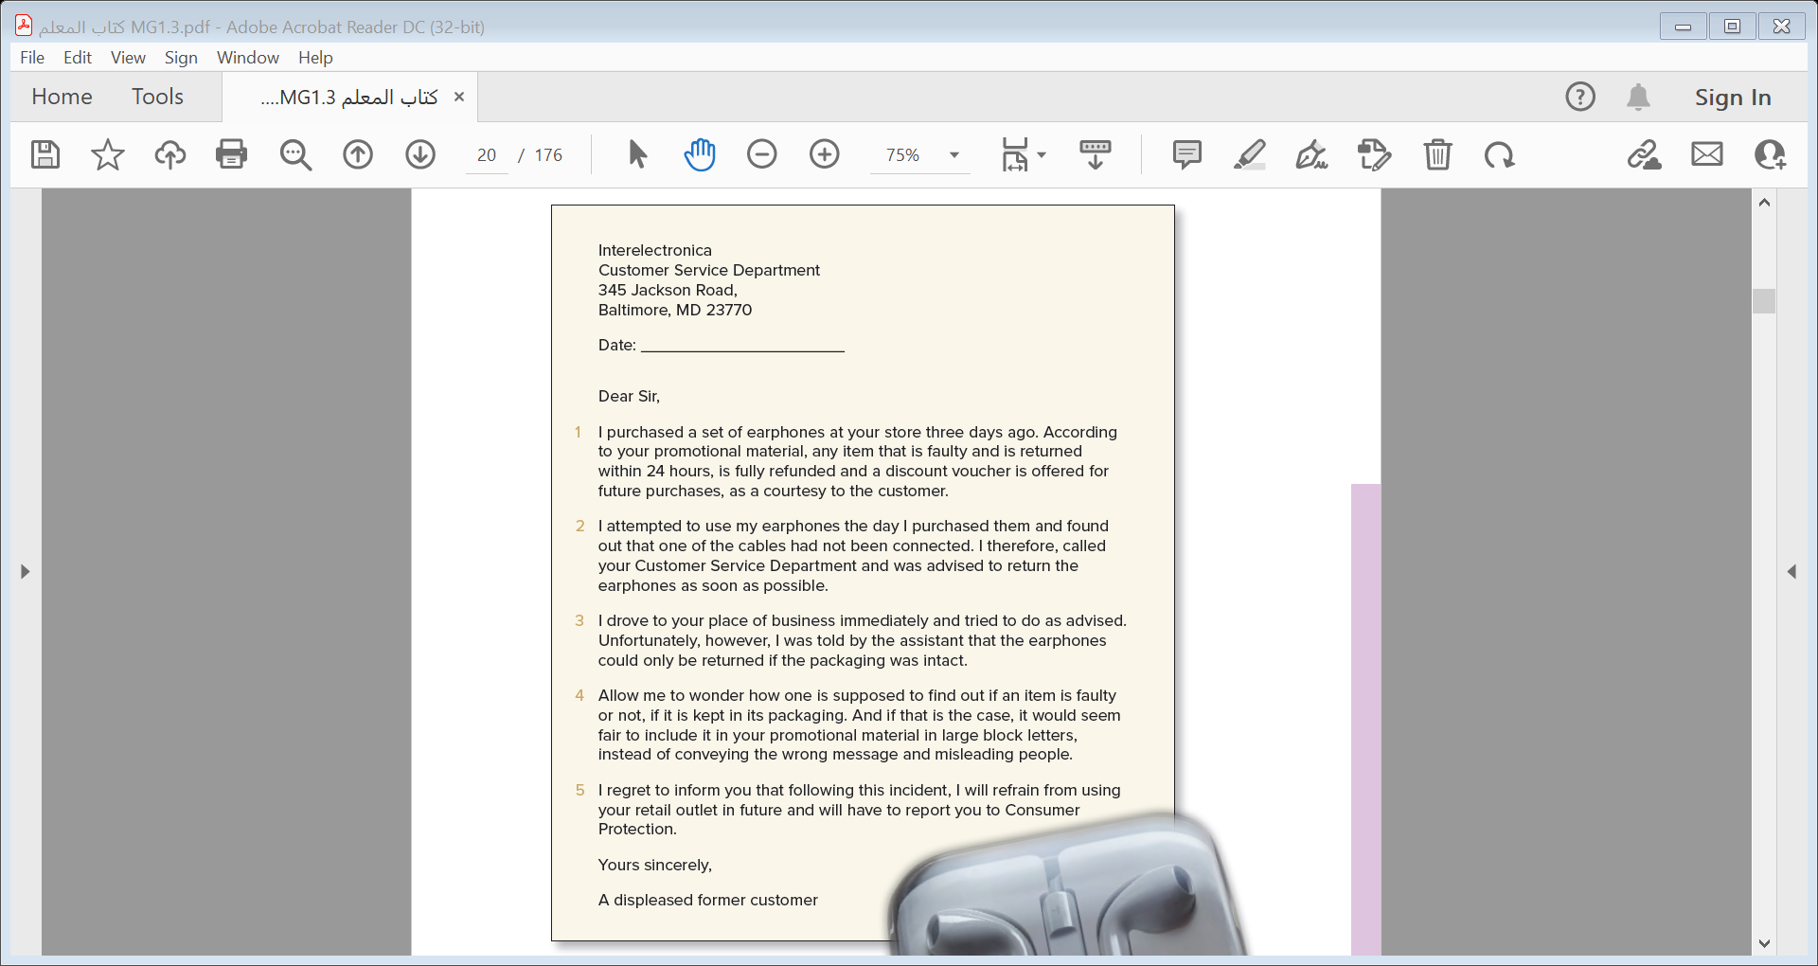
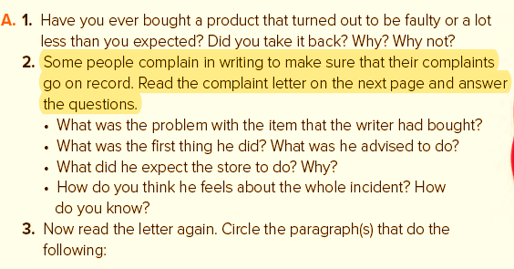
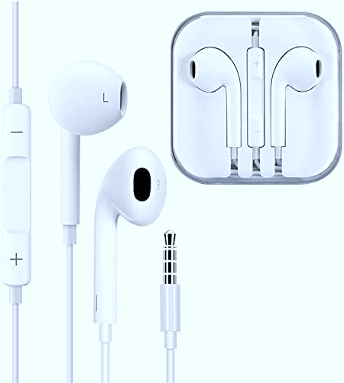

Slide 9


1
1
2
2
3
3
4
4
5
5

Slide 10
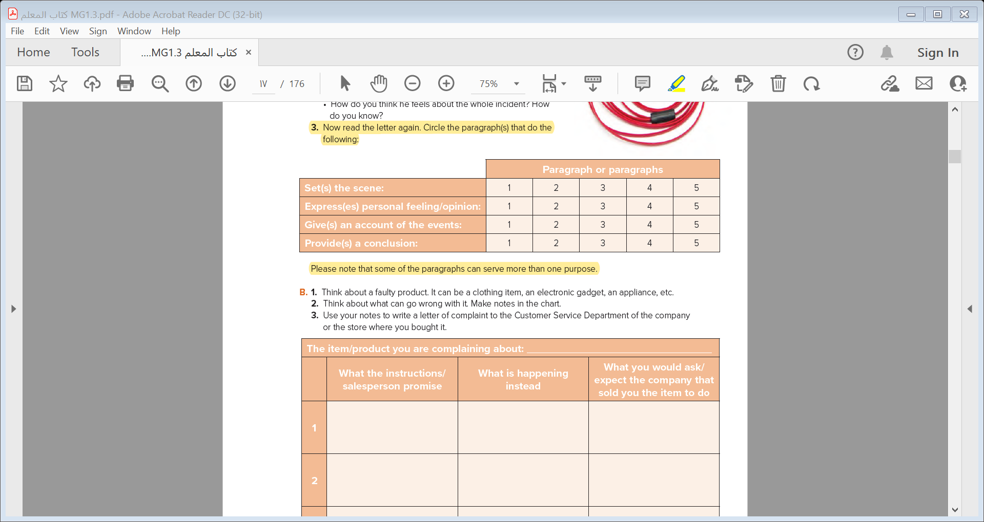
1
2
3
4
5

Slide 11
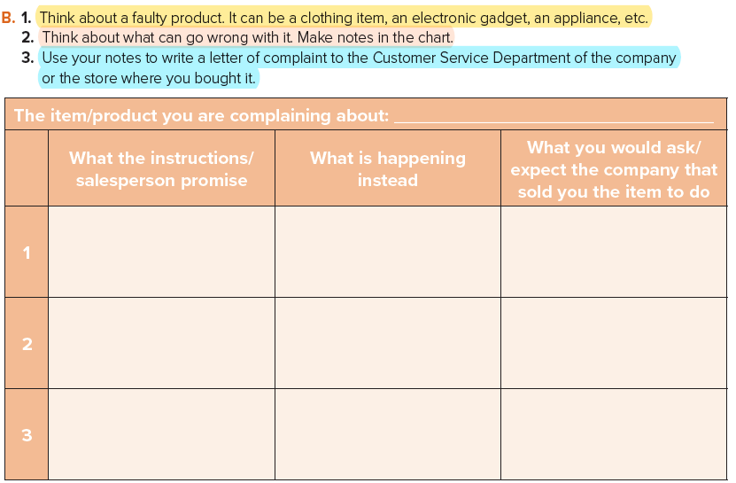
1
2
3
4
5
charger
refund or change
refund / on sale
refund or change

Slide 12
Address of the company
1
Account of the event
2
Set the scene
3
4
Express personal feeling
5
Closing

Slide 13
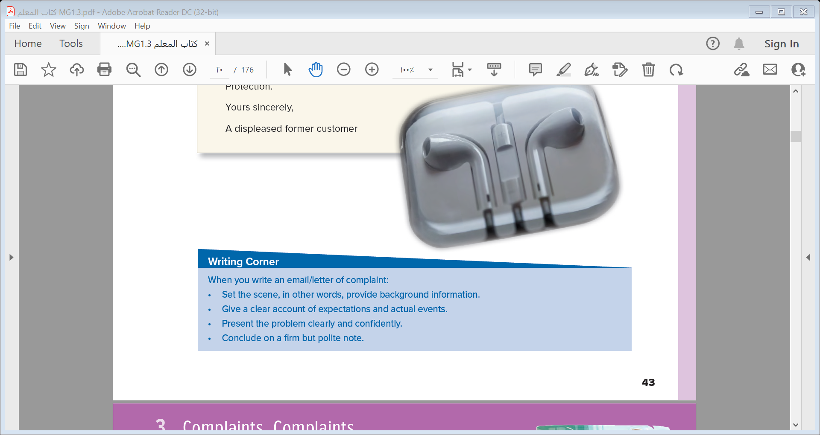
1
2
3
4
5

Slide 14


Slide 15
