Slide 1
Unit 1
Laugh Out Loud
Reading
Done by: Entisar Al-Obaidallah

Slide 2
Goals of Lesson
01
02
03
04
Discuss
Read
Answer
Find
the topic of laughter
for specific information
True –False questions about the passage
The meaning of the new words

Slide 3
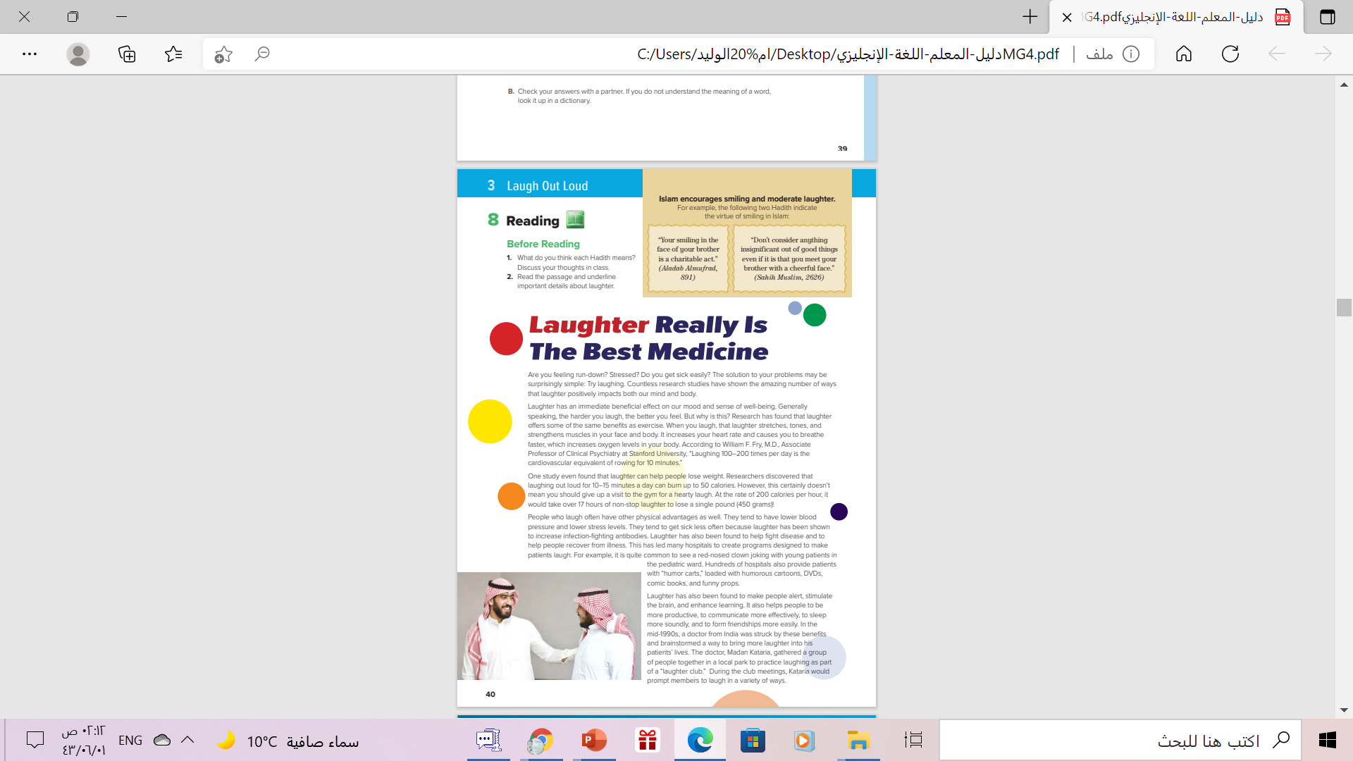
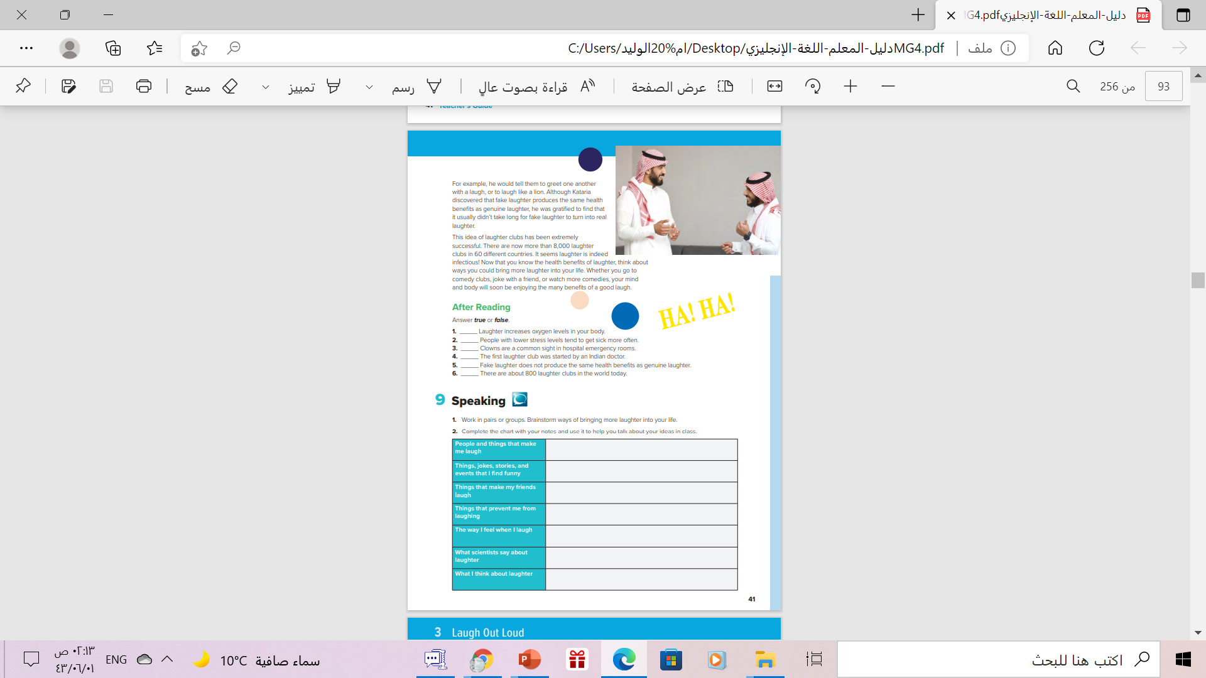

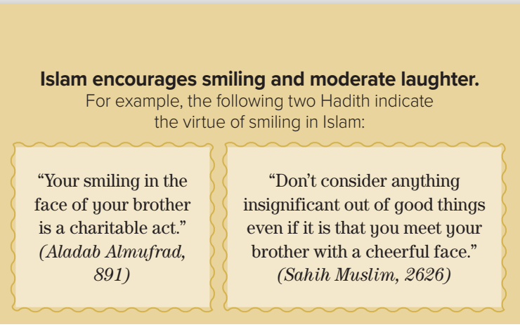
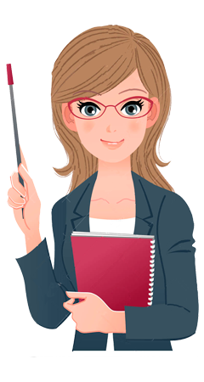
📍
MG 4 , Unit 4 , Reading . Hadeeth
قال النبي صلى الله عليه وسلم
١. «تبسمك في وجه أخيك صدقة»
وقال عليه الصلاة والسلام
٢. :(لا تحقِرنَّ من المعروف شيئًا، ولو أن تلقى أخاك بوجه طَلْقٍ)
.
What do you think each Hadith means?
قال النبي صلى الله عليه وسلم
١. « تبسمك في وجه أخيك صدقة »
وقال عليه الصلاة والسلام
٢. :( لا تحقِرنَّ من المعروف شيئًا، ولو أن تلقى أخاك بوجه طَلْقٍ )

Slide 4
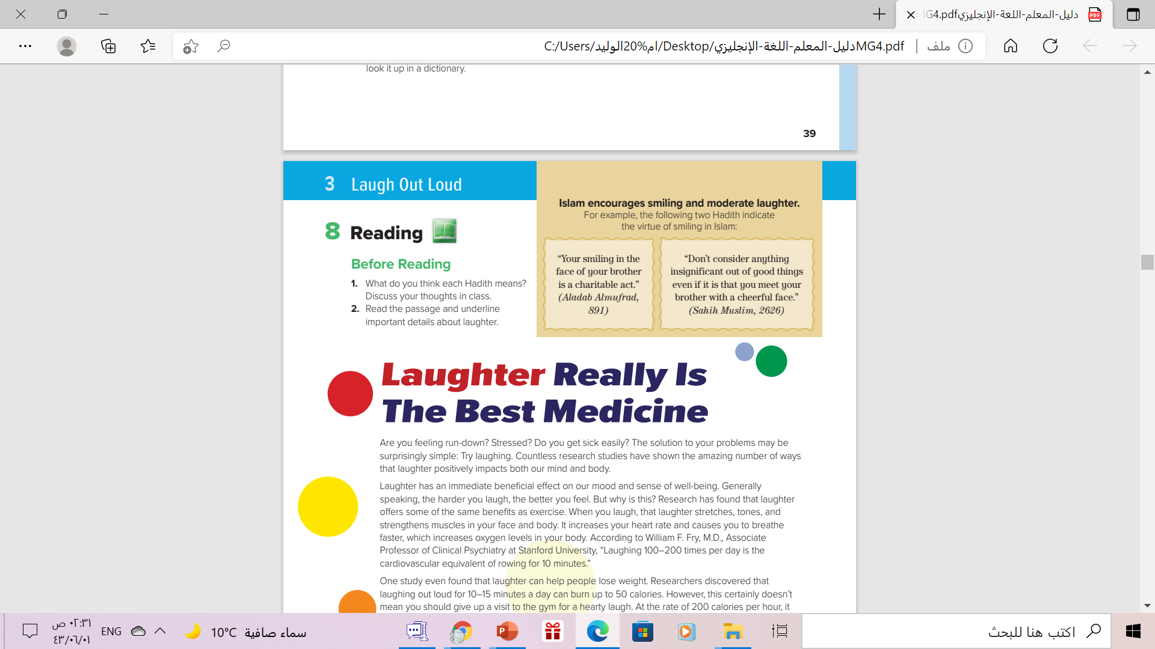
Is Laughter Really
The Best Medicine?

Slide 5

Book Open
pages (12-13 )

Slide 6
6
7
1
What is the title of the text?
2
Laugher Really Is the Best Medicine
3
4
How many paragraphs are there?
5
7 paragraphs

Slide 7
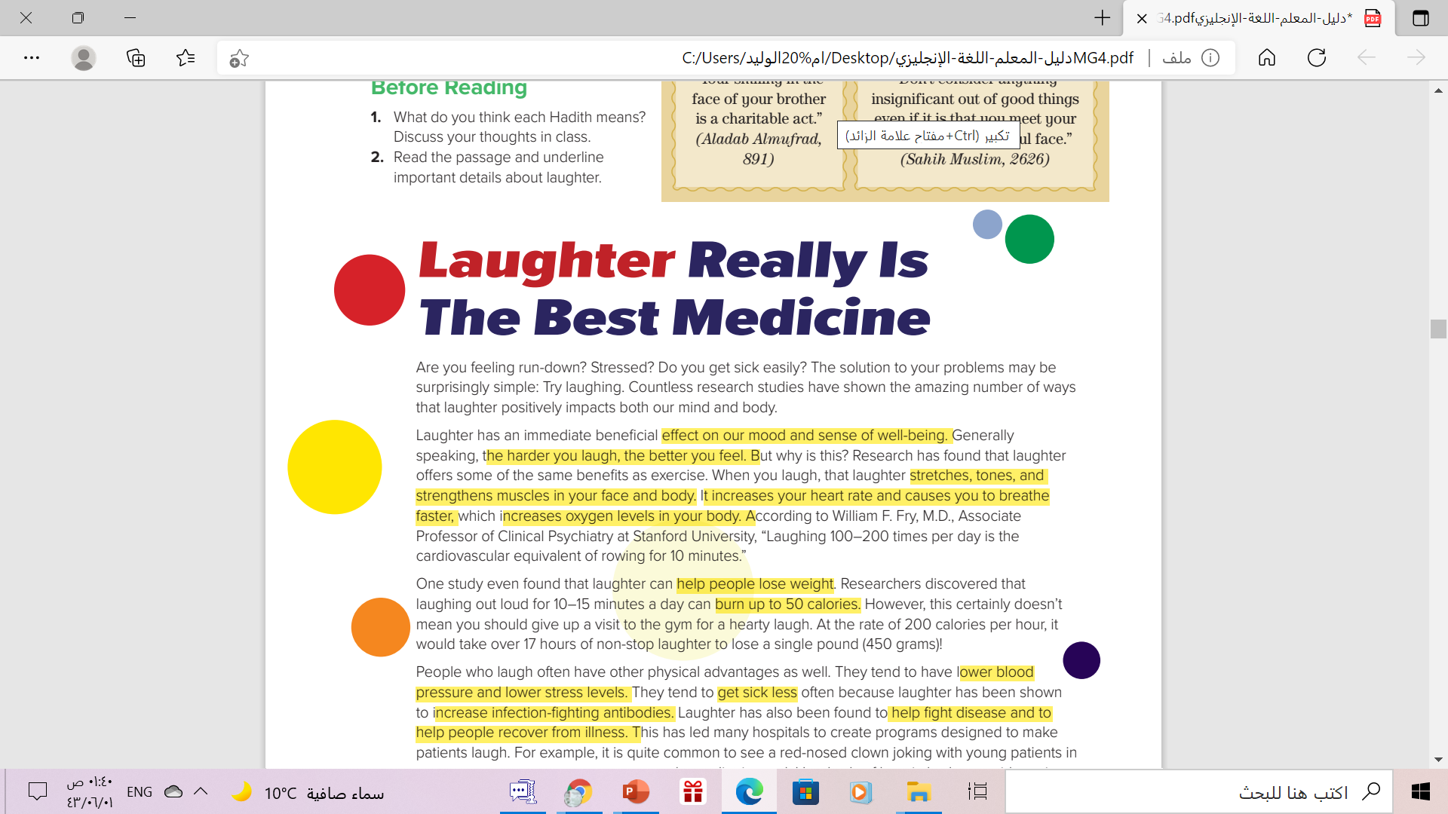

1
Which sentence summarizes the main
points the article will make?

Slide 8
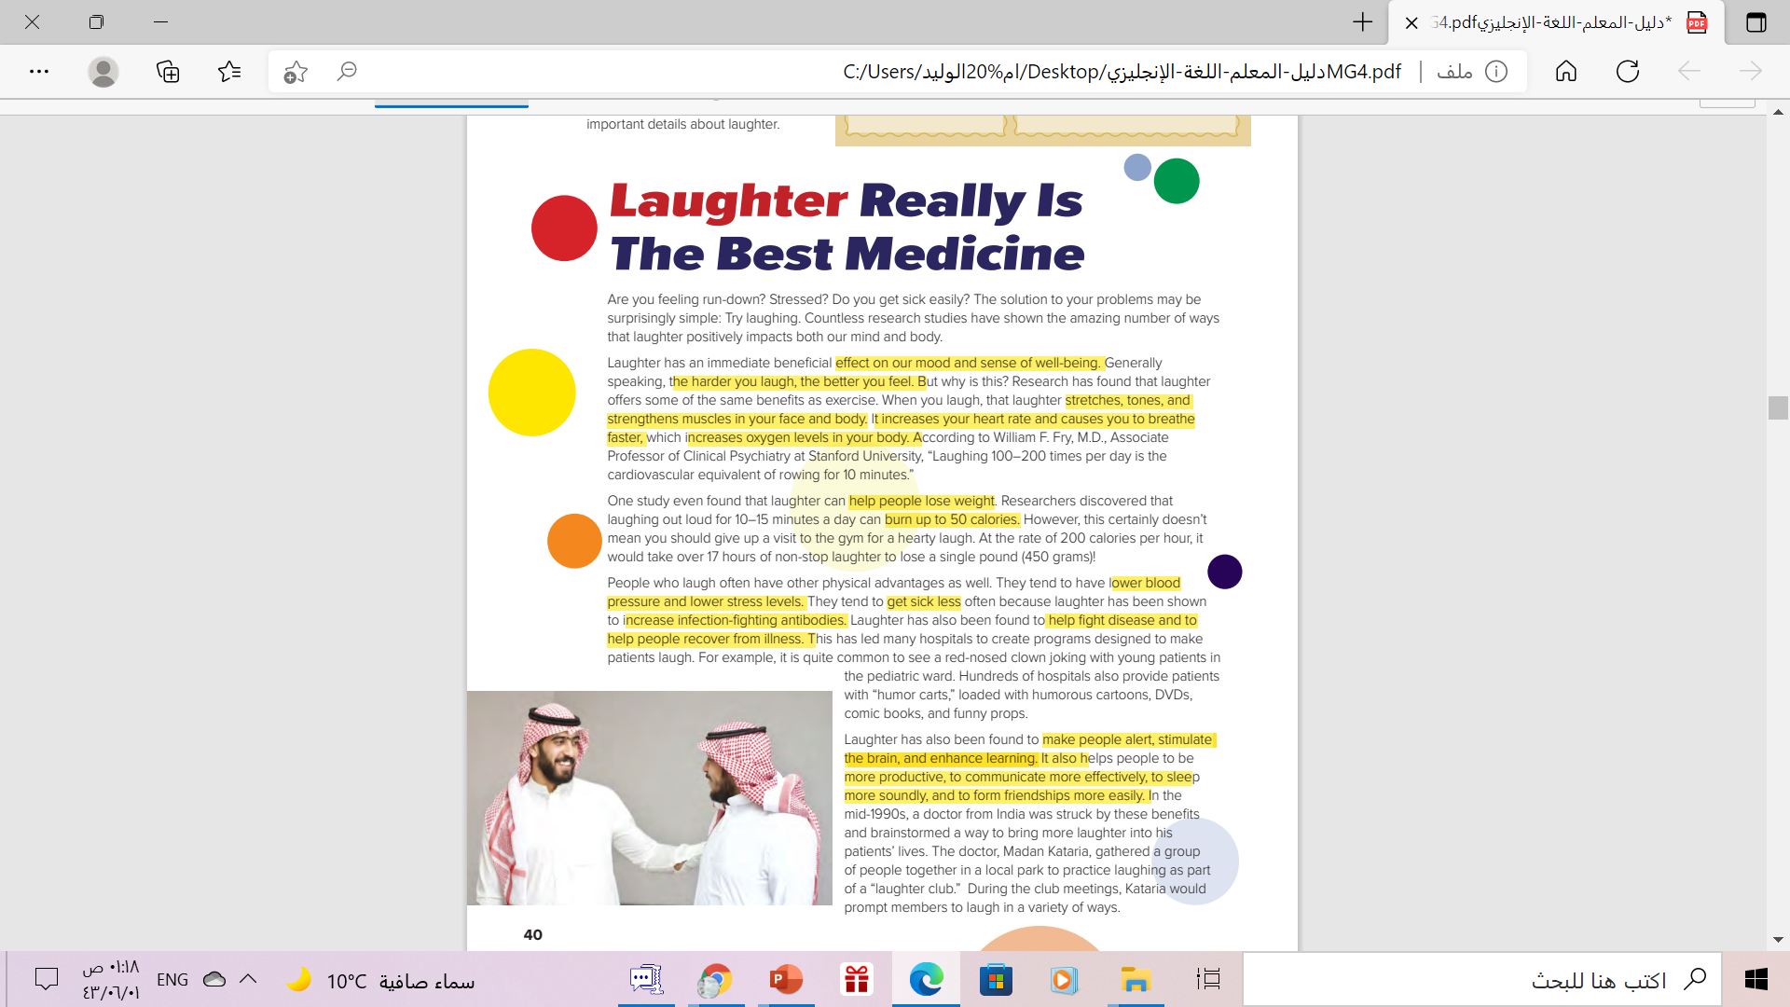
2
Which Paragraph does show the effect of laughter on
Body
3
4
5

Slide 9
2
Which Paragraph does show the effect of laughter on
Brain
3
4
5

Slide 10
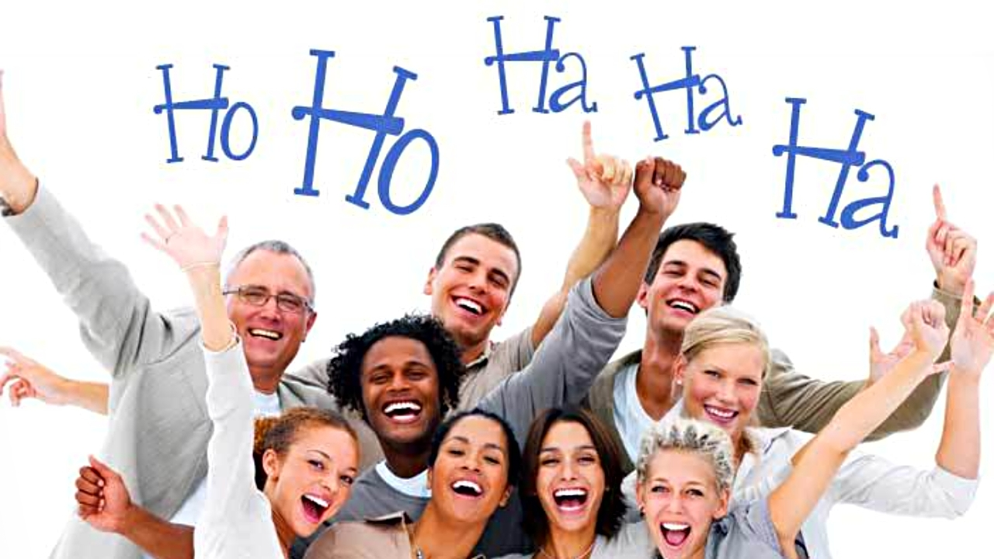
Laughter club means: a group of people who meet regularly to take part in communal laughing for therapeutic effect
Have you ever heard of a laughter club? What does it mean?
They begin with simple breathing techniques, clapping, and chanting to help people relax. For example, they may begin the class by clapping rhythmically 1-2, 1-2-3 while chanting “ho-ho, ha-ha-ha.”
What do you think that people do there?

Slide 11


Slide 12

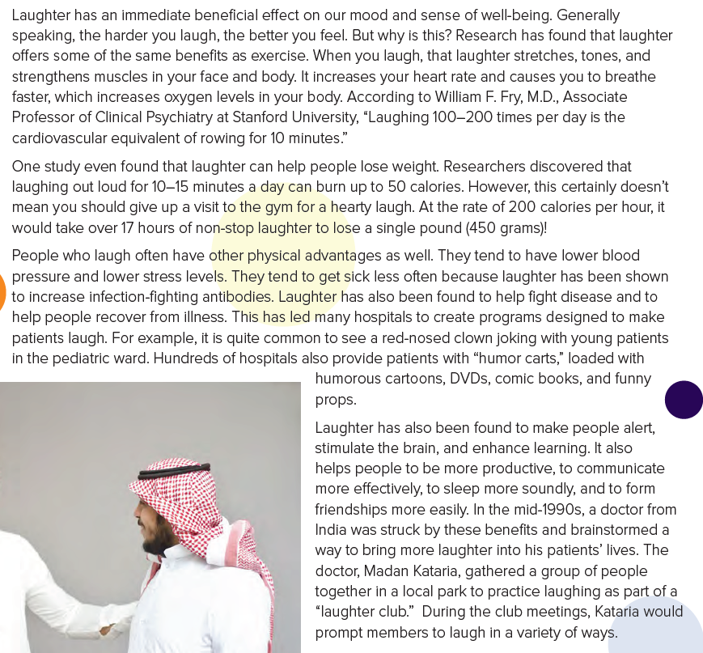
Find a word…….
that means to make the
muscles longer.

Slide 13
Find a word…….
that means to get better
after an illness

Slide 14
Find a word…….
that describes how a
person sleeps when they sleep well

Slide 15
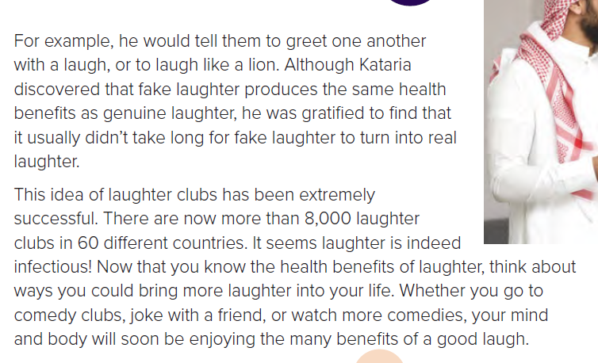
Find a word…….
means that something can be easily passed to another person such as a disease
That is a synonym for genuine.
that means the opposite of genuine.

Slide 16
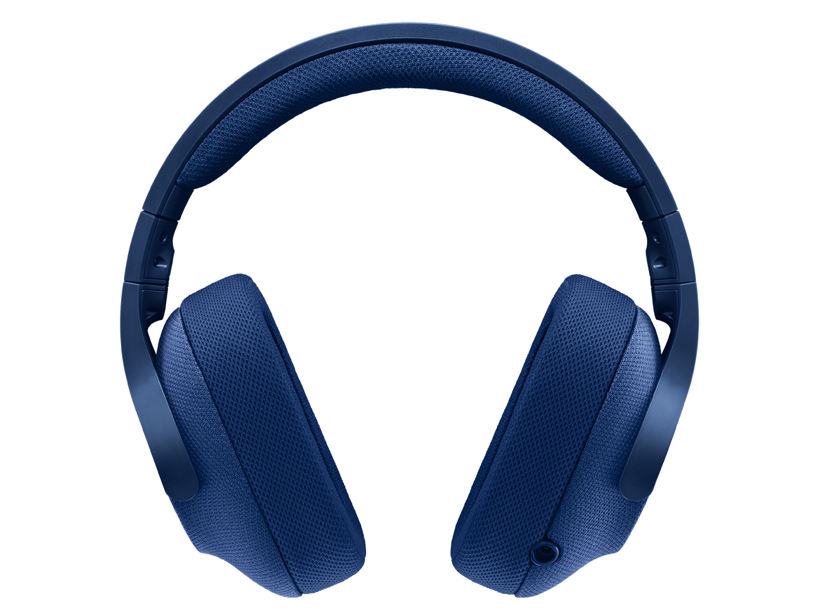
Read along as you listen
pages (12-13 )

Slide 17
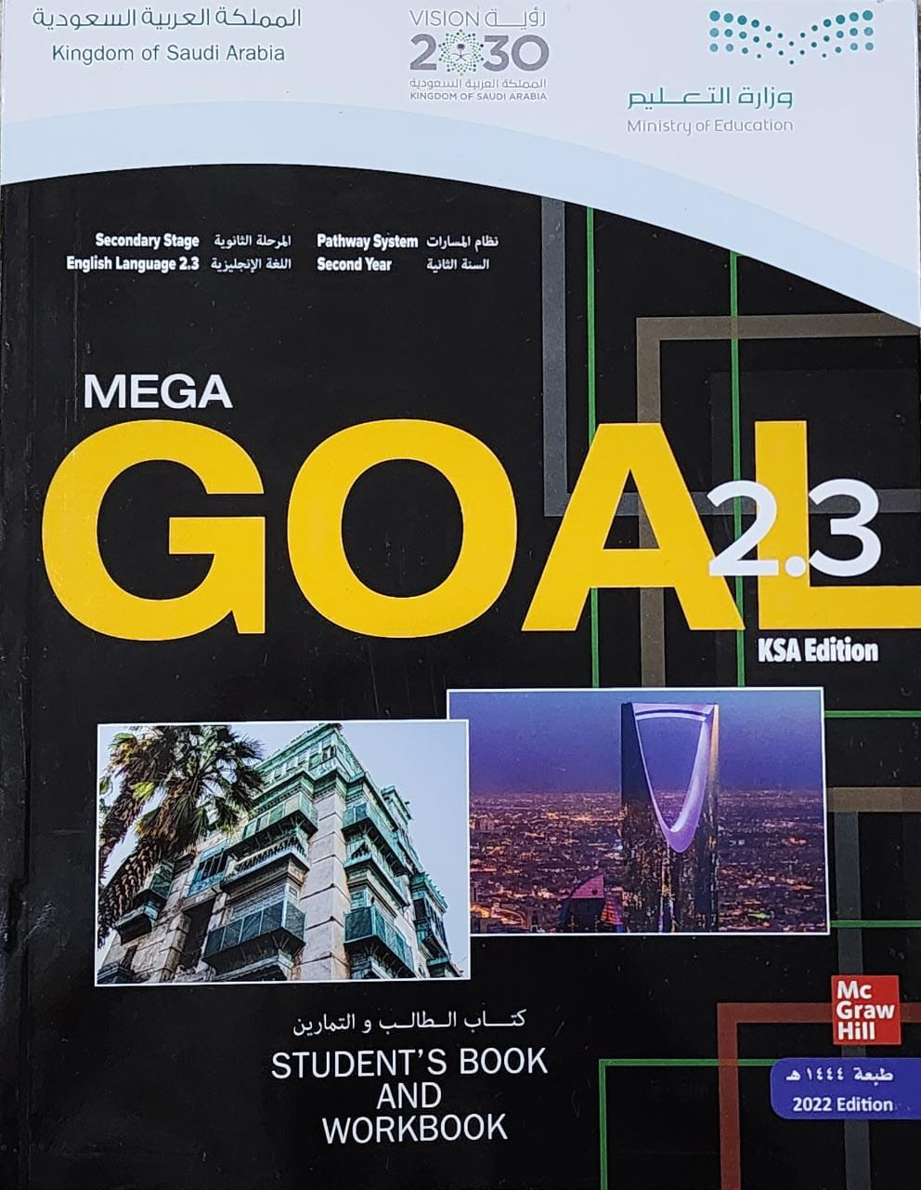
Book Open
Page ( 13 )

Slide 18
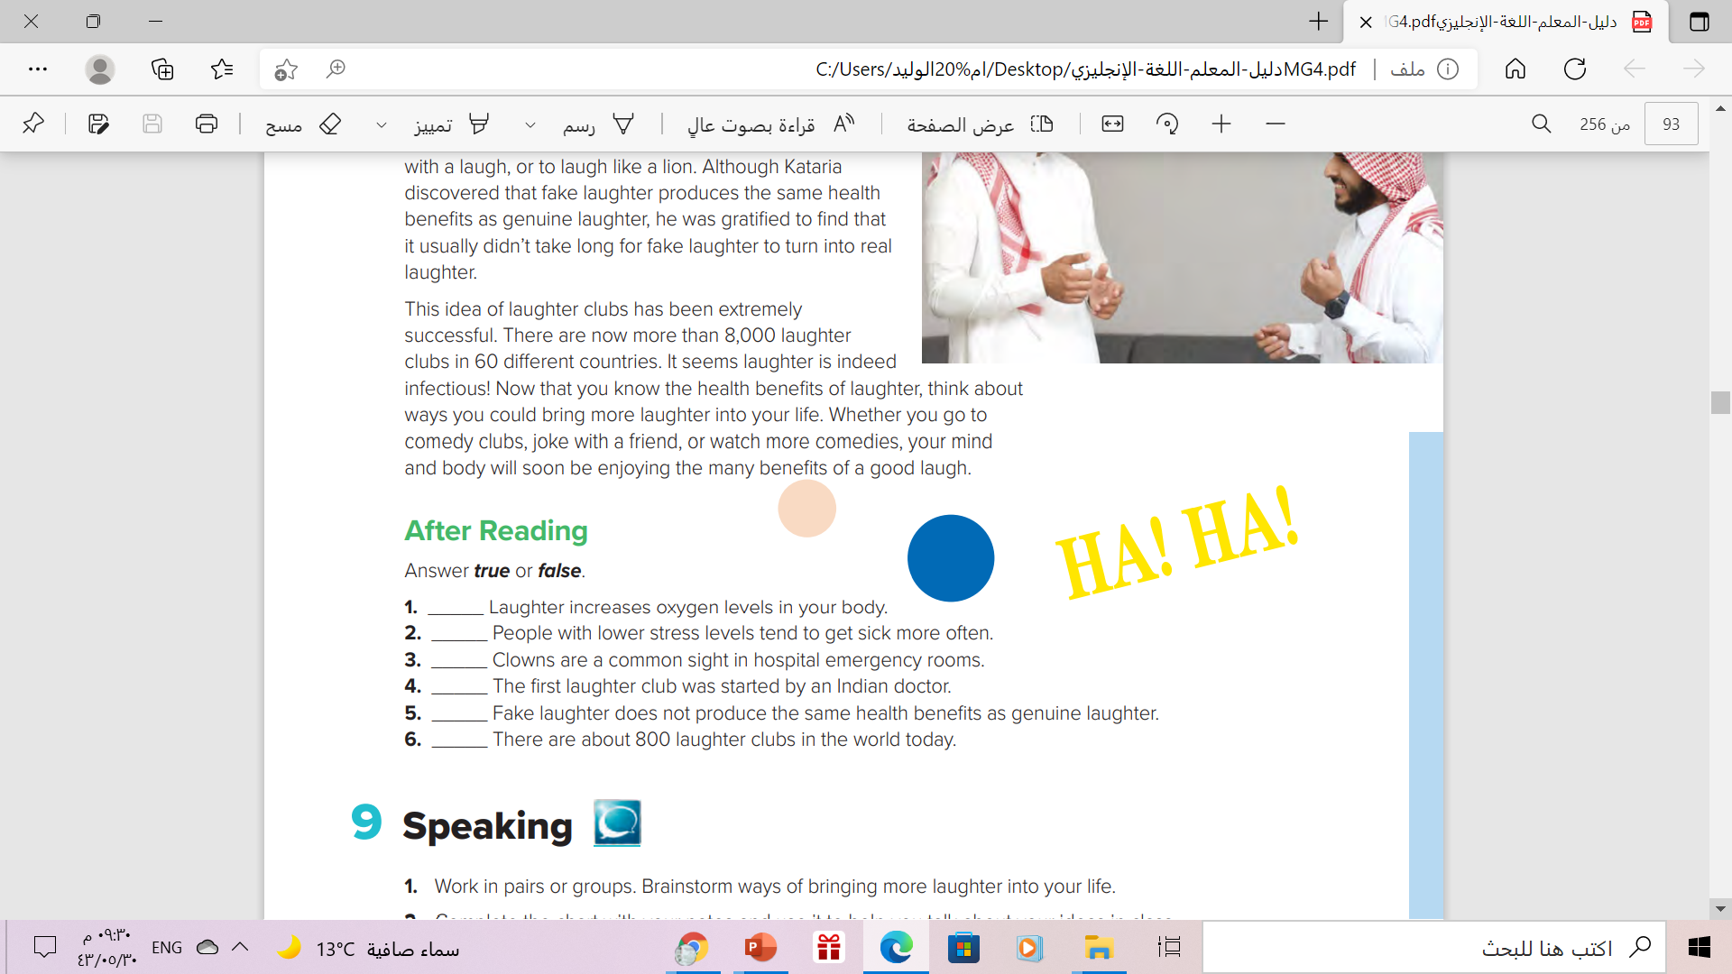
T
F
F
T
F
F

Slide 19
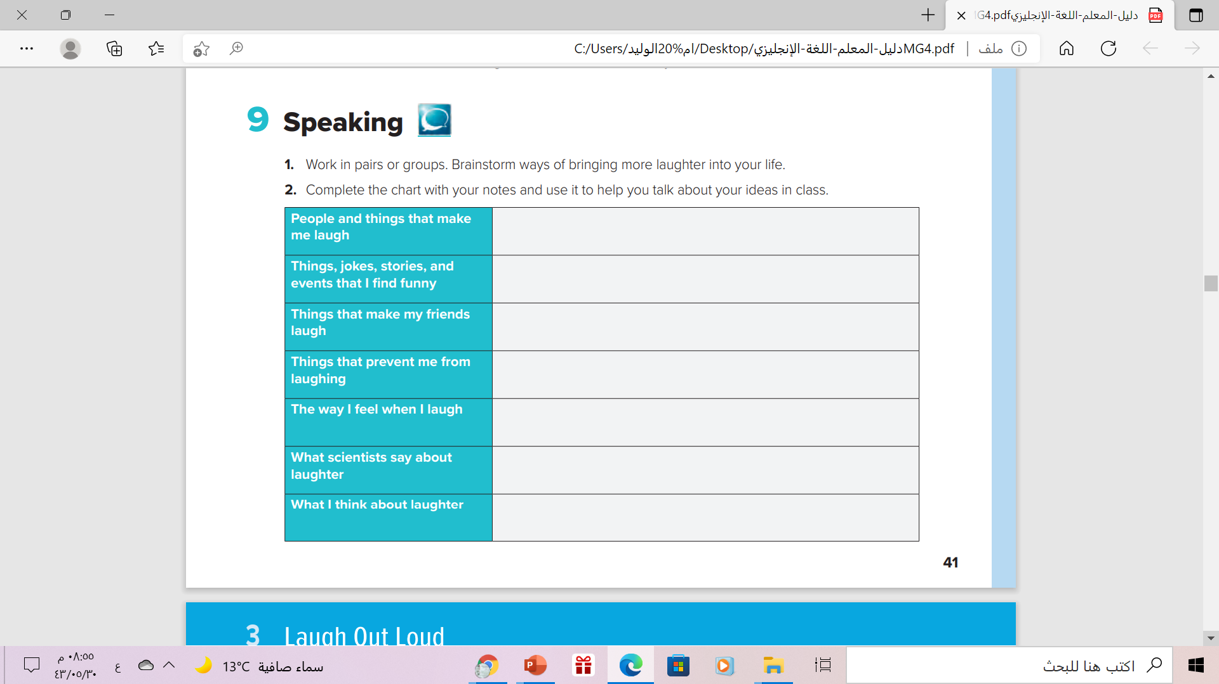
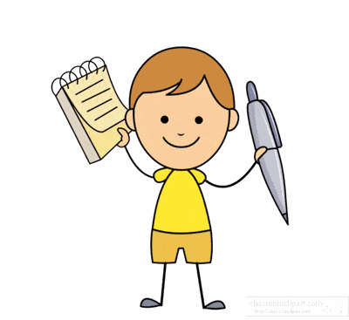

Slide 20
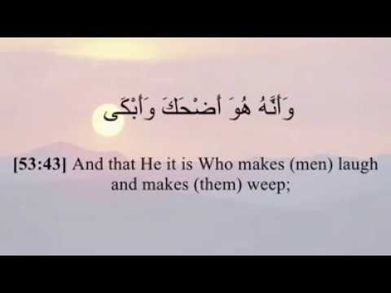
Remember..

Slide 21
Homework
Workbook , page ( 85 ) exercise ( H )

Slide 22

Thank You!

