Slide 1

Unit 1
Lough Loud Out
Writing
Mega Goal 2.3
Done by: Entisar Al-Obaidallah

Slide 2
Lesson Obectives
01
02
03
04
Analyze
Match
a text to about a sitcom correctly
the date with the event according to a sitcom
Answer
Write
questions about the text correctly
a description for the final scene to the sitcom

Slide 3

What does the picture show?
Where they are?
What are they doing?
What are they doing?
Why are they laughing?

Slide 4



What is a sitcom ?

Slide 5


Open
Student’s book page ( 14 )

Slide 6
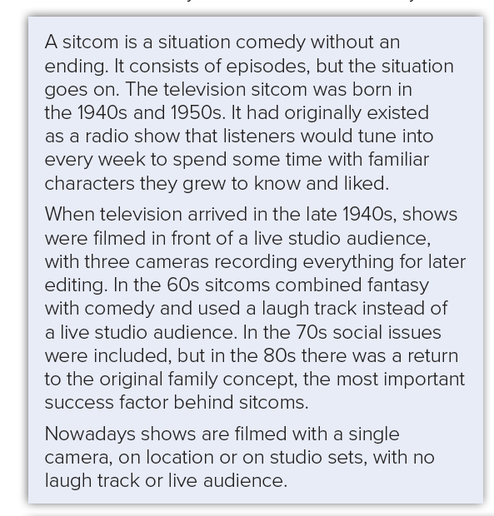

Read & find out what sitcom is

Slide 7


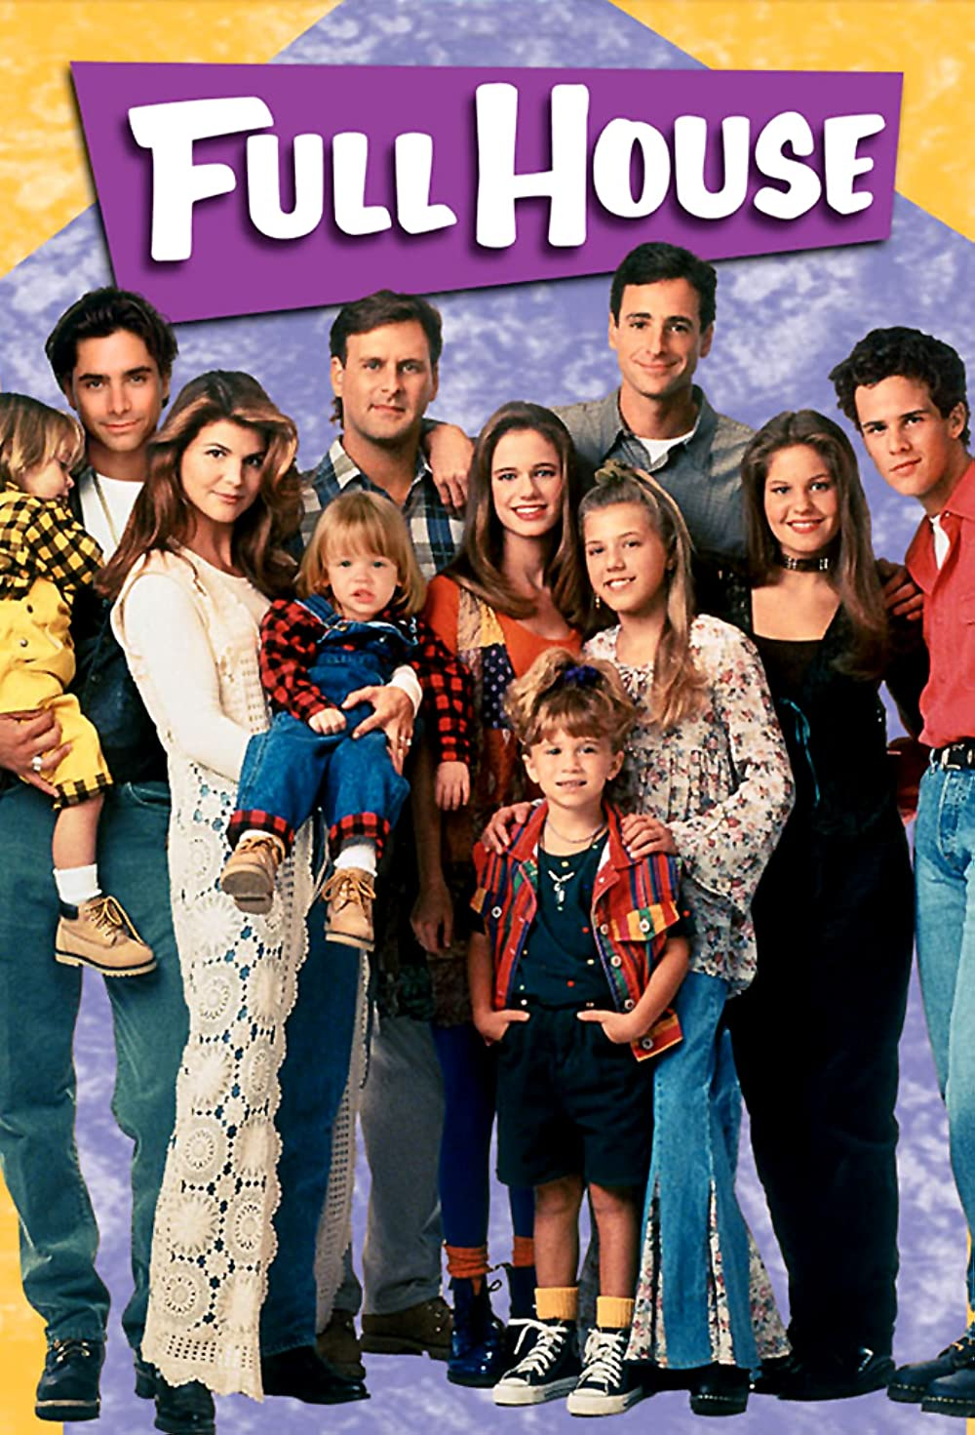

Do you enjoy watching sitcoms? Why ?
Why not?
Who are your favorite characters?

Slide 8

Read & Highlight
key features
for each period

Slide 9
1940s
filmed in front of live studio audience
three cameras, later editing
1950s
sitcom was born (weekly radio show)
familiar characters
1960s
fantasy and comedy
laugh track
1970s
social issues
1980s
return to family concept
success factor
Now
single camera on location or studio set
no laugh track, no live audience

Slide 10
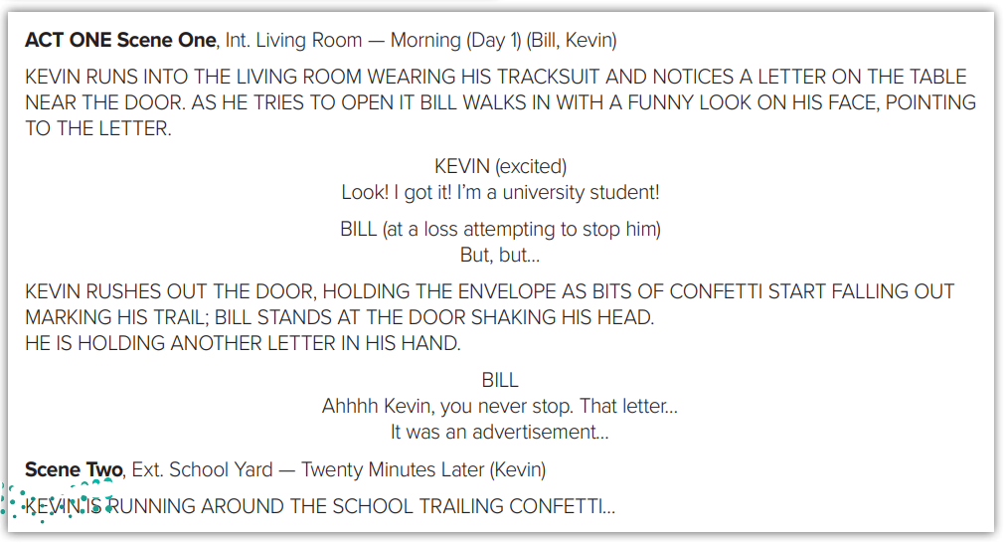
Read & find out
Who the main characters are
What has happened?
Characters: Bill and Kevin
Plot: Kevin seizes a letter, reads it and gets excited before dashing out. Bill is trying to explain something, but Kevin rushes out of the door and doesn’t notice Bill..

Slide 11
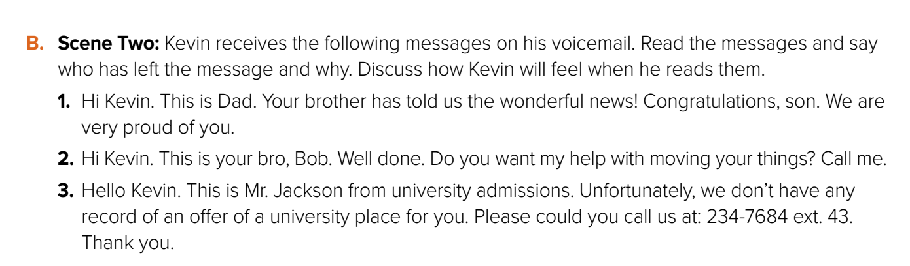
1- His father . He was cheered and proud
2- Ali . He was grateful
3- Mr. Jakcson . He was disappointed .
who has left the message and why?
Can you speculate how Kevin will feel when he reads them?

Slide 12
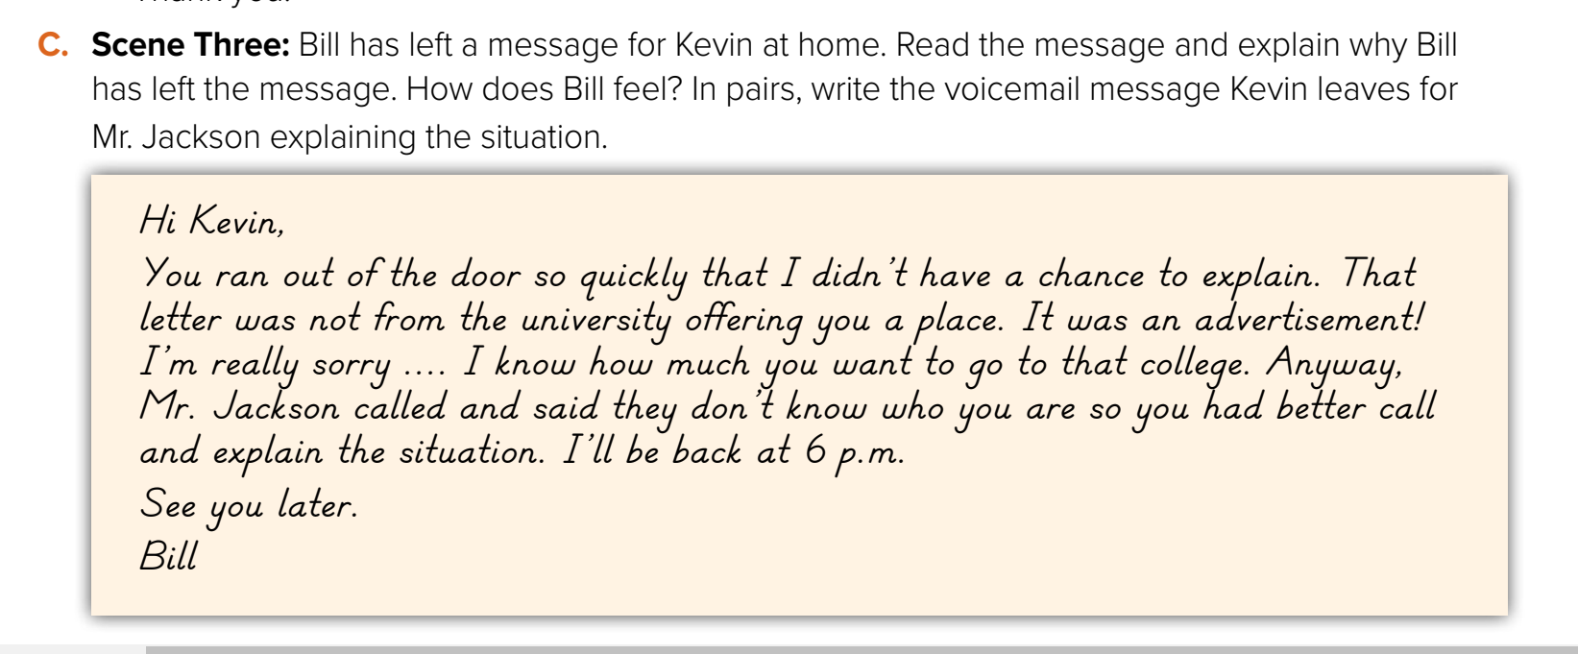
How does Bill feel?
who has left the message and why?
1- From Bill to explain that letter was not from the university offering him a place.
2- He feel sorry about Kiven.

Slide 13
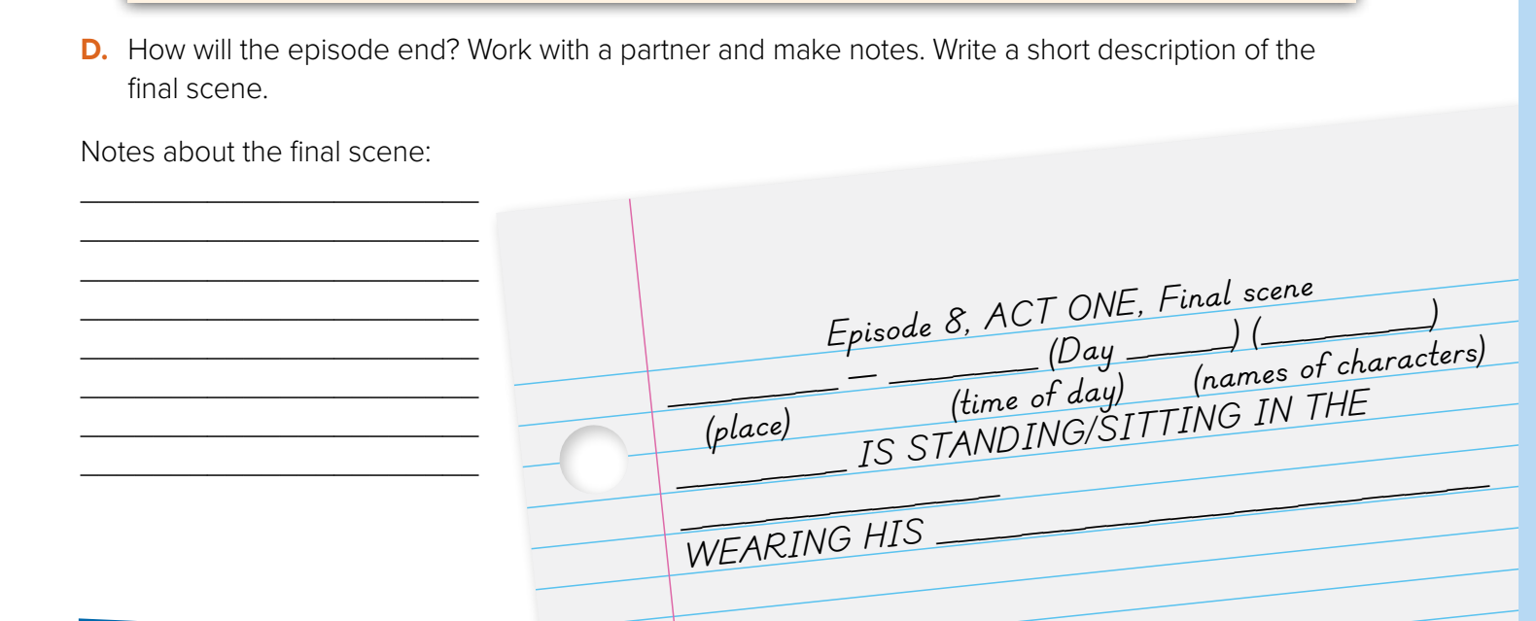


Slide 14
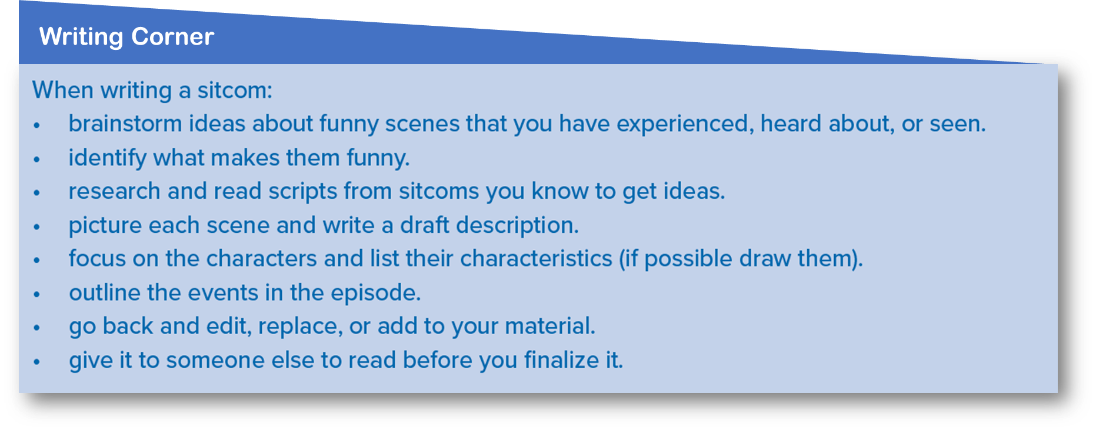
Remember: Follow these steps when you writing a sitcom:

Slide 15

Remember

Slide 16
Homework
Workbook , page ( 8) , exercise ( K)

Slide 17


THANKS!

