Slide 1
Unit1
Complaints,Complaints
Reading
Mega Goal 1.3
Done by: Entisar Al-Obaidallah

Slide 2
01
02
03
04
Lesson Objectives
Read
Recognize
The passage for specific information
the sentences that talk about something that went wrong.
Explain
Discuss
what Murphy’s Law means
Murphy’s law using their experience

Slide 3
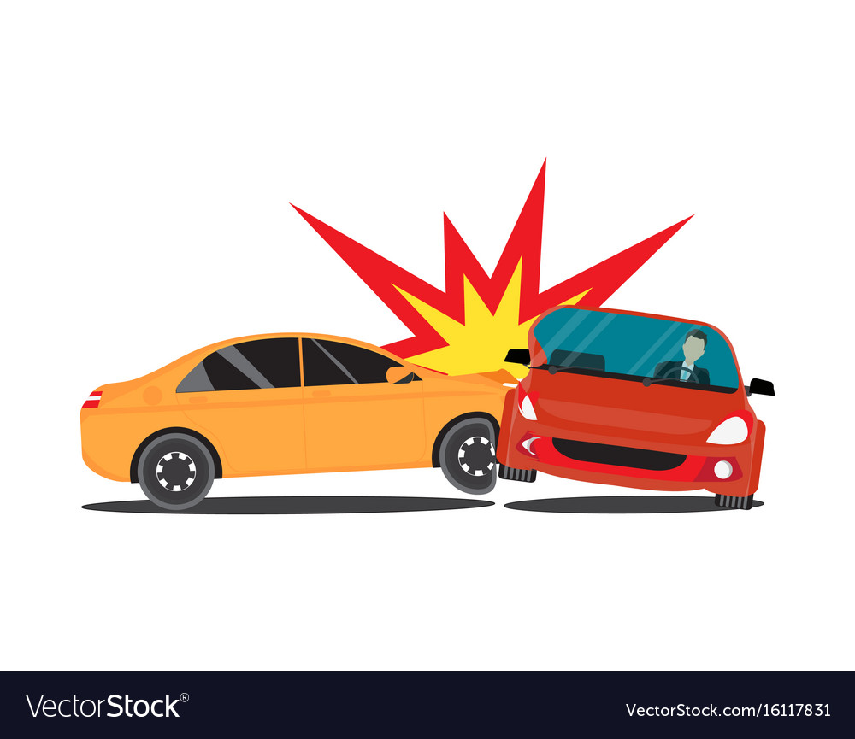

Warm up
Have You Ever Heard of Murphy’s Law?

Slide 4
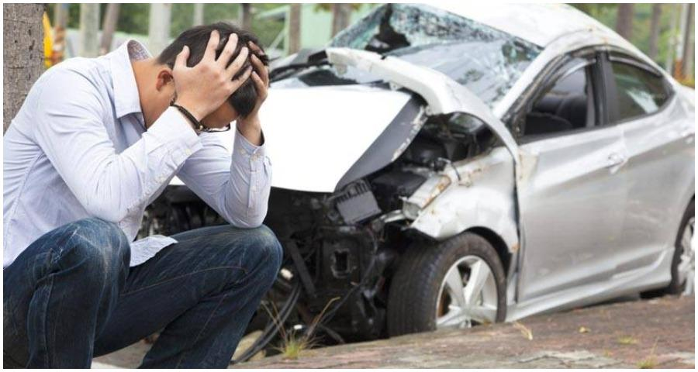

Hypothetical situation:
Warm up
A 22-year-old guy has been driving for five years , but he has already been involved in six car accidents.
Does he simply have bad luck,
OR
are there other factors that might have caused him to have so many accidents?

Slide 5
Open
Your student’s book p. 12

Slide 6
01
Before Reading

Slide 7
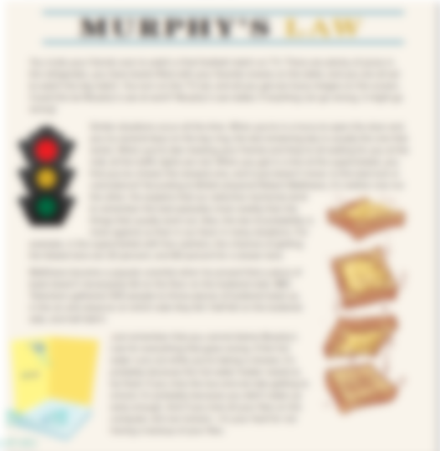
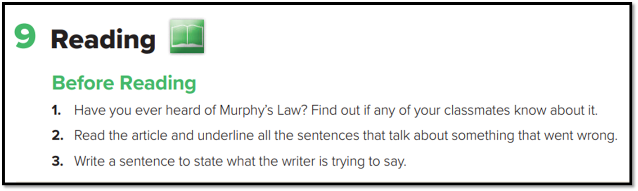
Before Reading

Slide 8
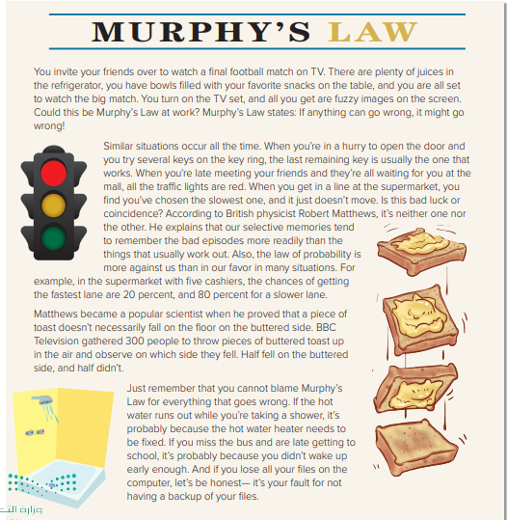
what is the title of the passage?
1
Murphy’s Law
2
How many paragraphs are there?
4 paragraphs
What do pictures show ?
3
Traffic Lights - falling bread with peanut butter and a shower
4
Can you predict what are you going to read ?
About Murphy’s Law

Slide 9

Read and Listen carefully:
What is Murphy’s Law?
(If anything can go wrong, it will.)
Why is it called Murphy’s Law?
Edward A.Murphy first used it to talk about a situation in his lab.

Slide 10
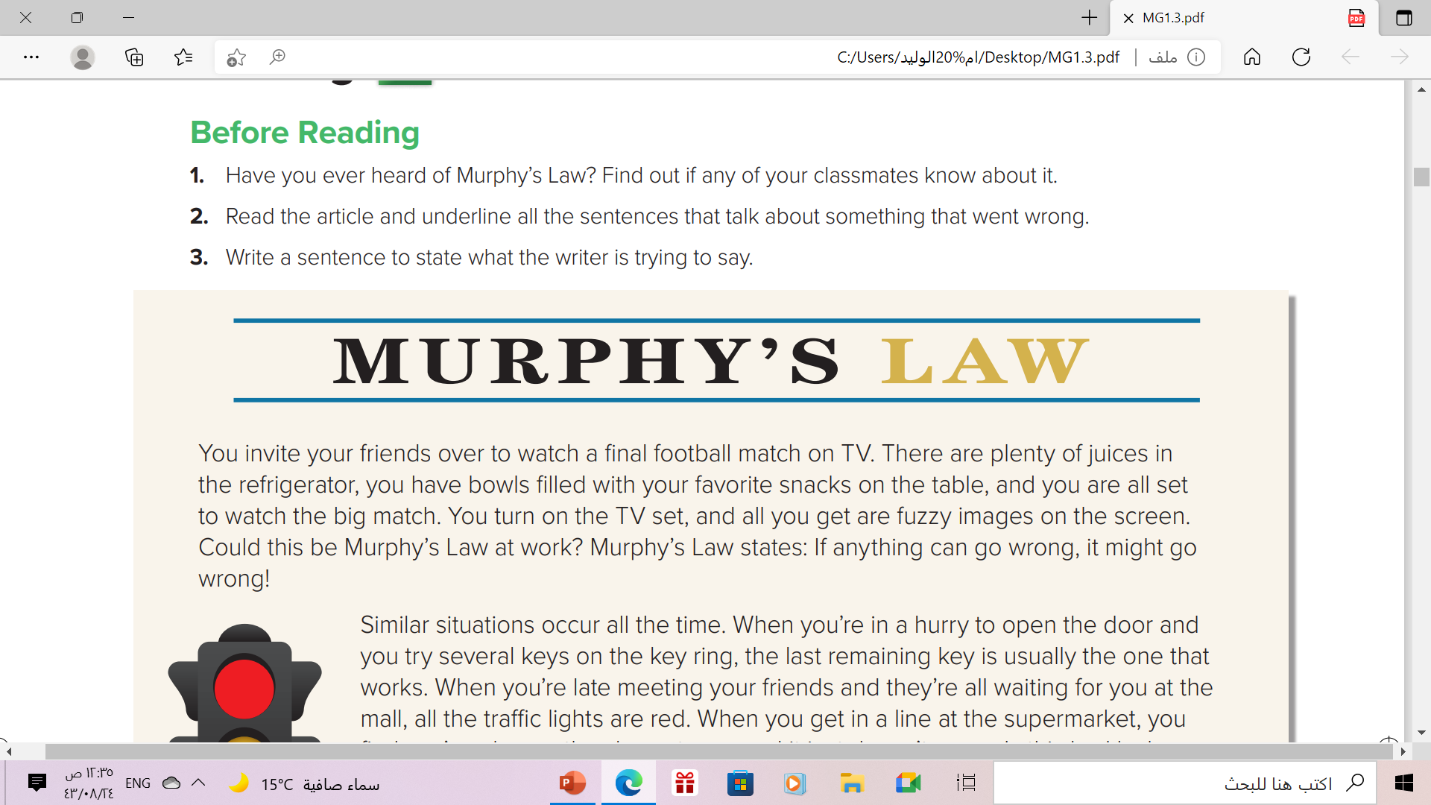

What does Murphy’s Law state?
Murphy’s Law states: If anything can go wrong, it might go wrong!
fuzzy = not clear

Slide 11
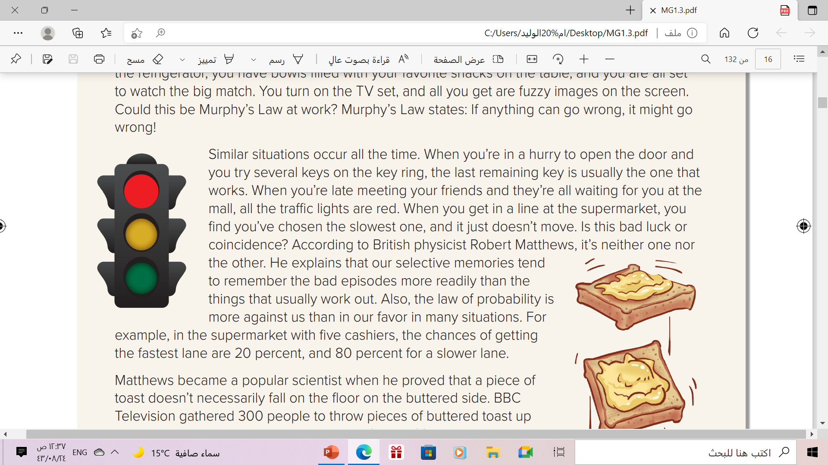

Which key does usually work when you try to open the door in a hurry according to the text?
the last remaining key is usually the one that works.
What’s the main idea of this paragraph?
Examples of Murphy’s law & Matthew's explanation
episode = event

Slide 12
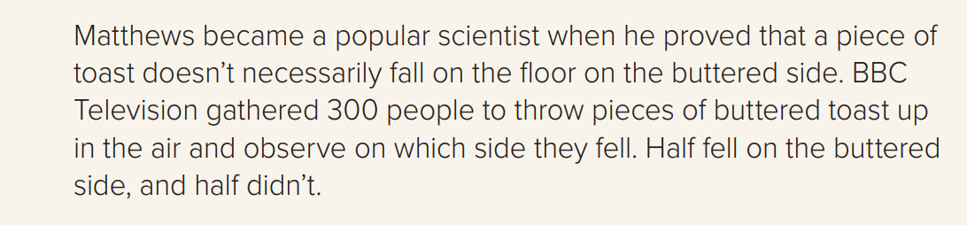
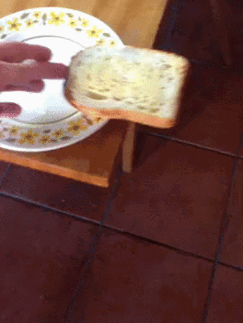
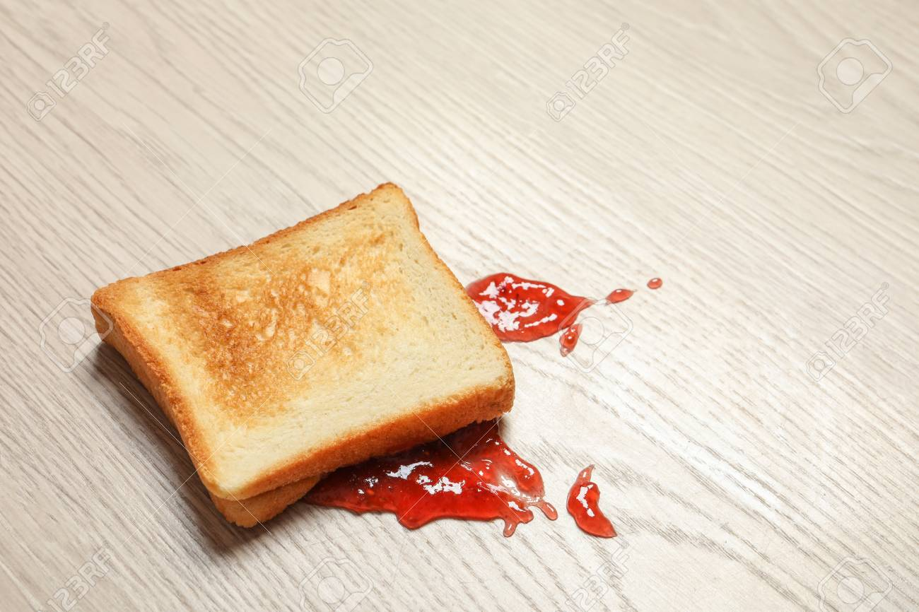
When did Matthews become a popular scientist?
when he proved that a piece of toast doesn’t necessarily fall on the floor on the buttered side.
How many people did BBC TV gather to the toast experiment?
300 PEOPLE

Slide 13
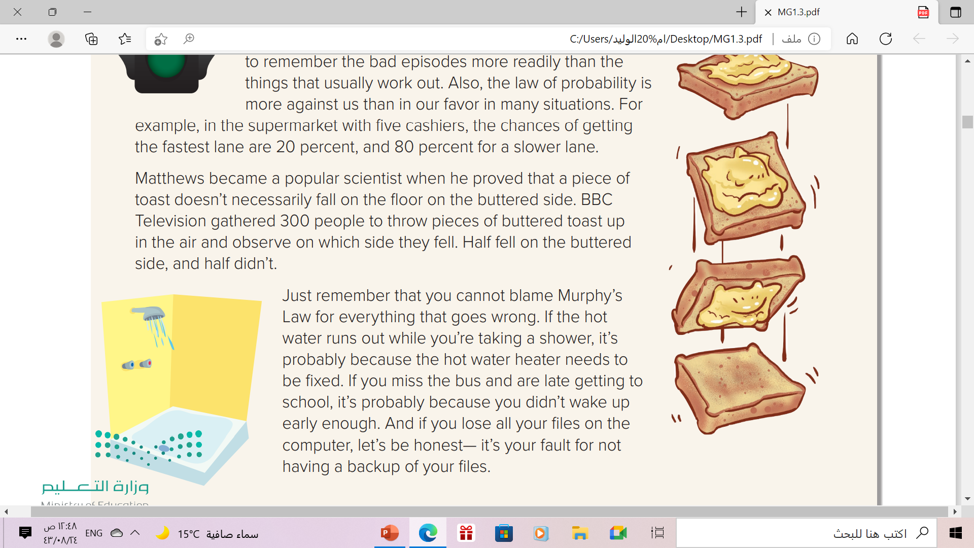
What is the writer’s question for Matthews?
Will the cat land on all fours, or will the toast land on the buttered side?

Slide 14
Can we blame Murphy’s Law for everything that goes wrong?
No, we can’t
Backup = copy

Slide 15
Open
Your student’s book p. 13

Slide 16
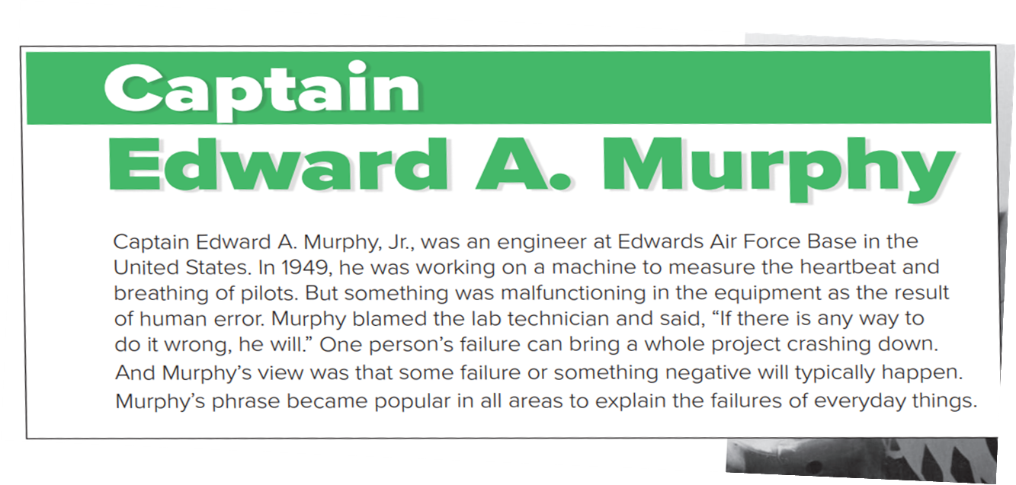
What is his job?
He was engineer
Where did he work ?
at Edwards Air Force Base in the United States.
malfunctioning= not working correctly

Slide 17
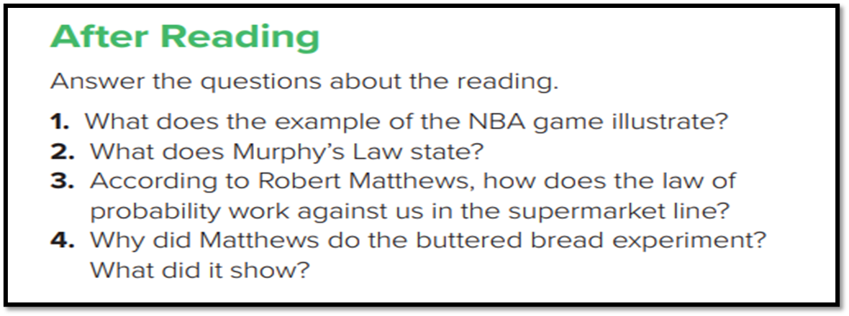
1. It illustrates that things seem to go wrong at precisely the wrong time.
2. If anything can go wrong, it will.
3. Because the chances of getting in the fastest lane aren’t that high.
4. He wanted to show that although people think that bad things
always happen, things happen according to the law of probability

Slide 18


Slide 19
Match the words to their meaning
Meaning | Word
copy
not working correctly
Not clear
event
Backup
backup
episode
malfunctioning
fuzzy
fuzzy
Malfunctioning
episode

Slide 20
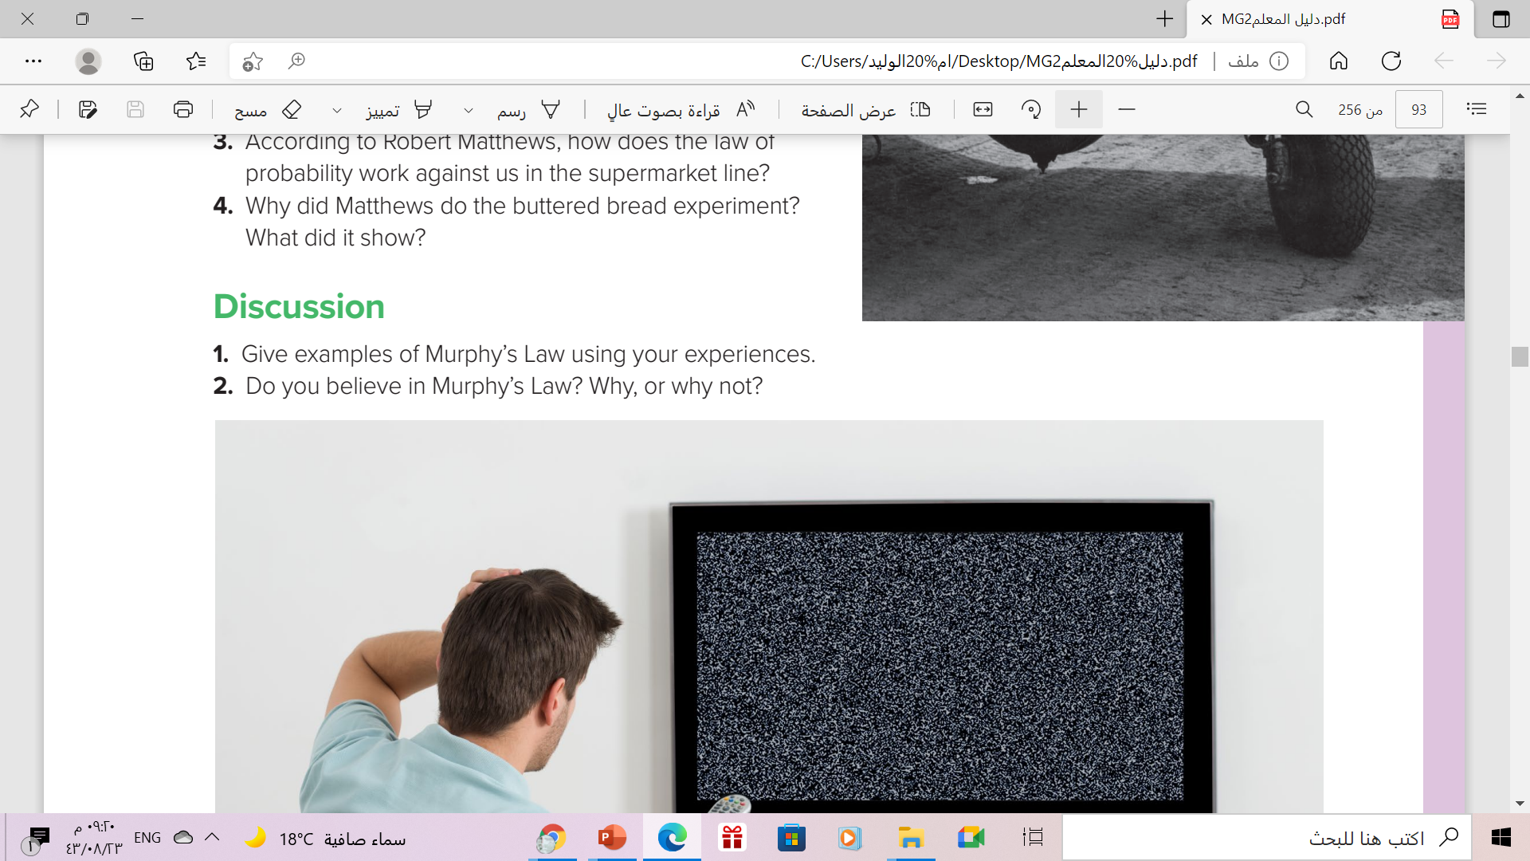
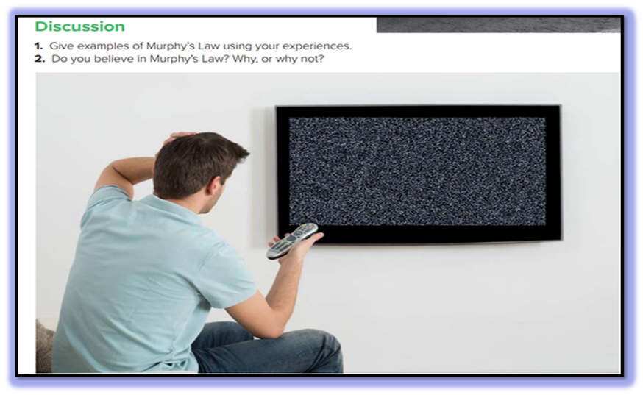

Slide 21
Homework
Your workbook exercise (G) p.83

Slide 22

THANKS!

