Slide 1
Unit 1
Two Is Better Than One
Writing
Mega Goal 5
Done by : Entisar Al-Obaidallah

Slide 2
Lesson Goals
02
01
04
03
Answer some questions about text.
Read for specific information
Use a venn diagram to write the qualities of two friends
Write a short essay about people’s qualities

Slide 3
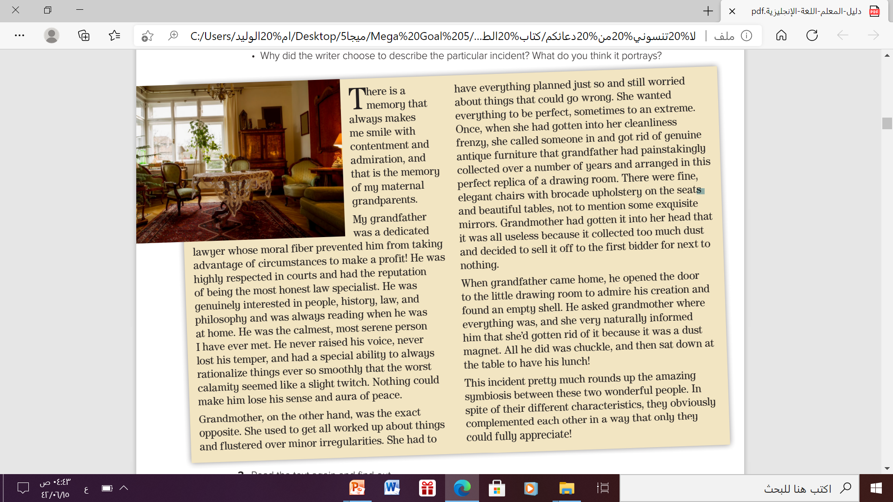
Open your student’s book p.14
What can you see in this photo?
furnitured room
What kind of furniture can you see in the photo?
Antique furniture
Who do you think it belongs to?
People who are interested in history , antique and classic things

Slide 4
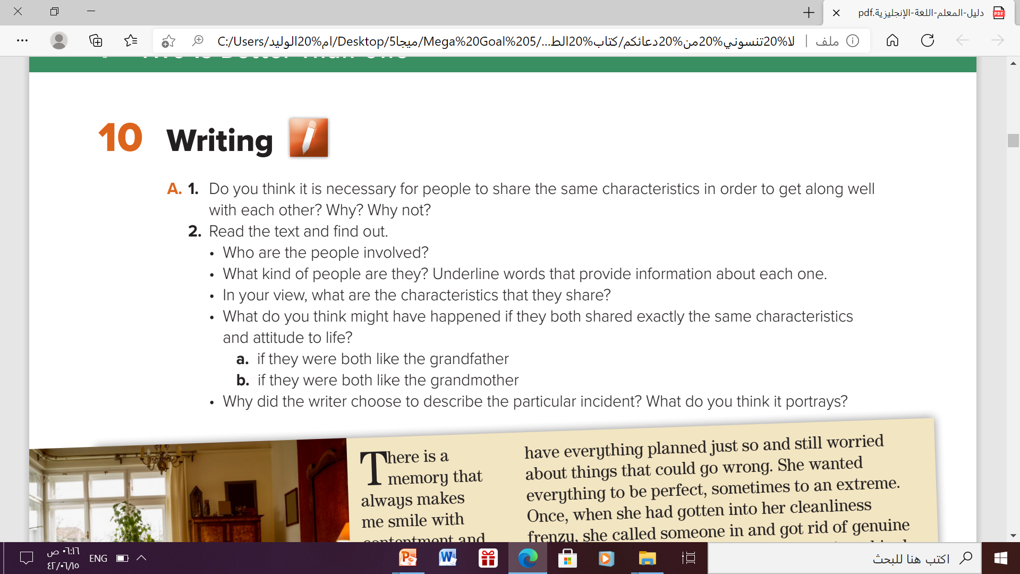
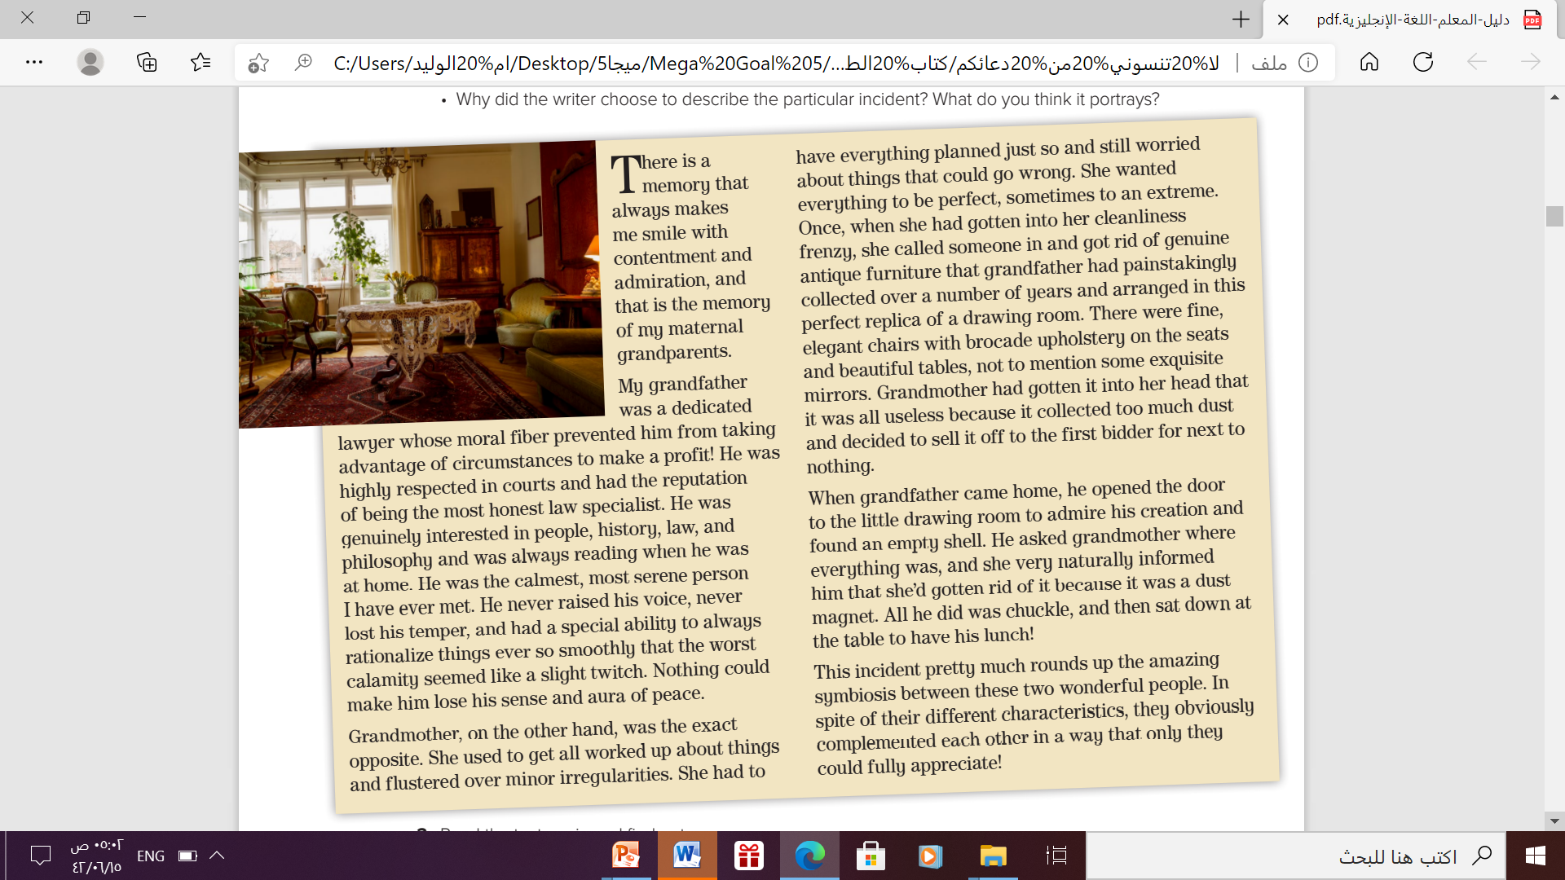
Writing
Read the text and find out:
• The writer’s maternal grandparents.
Grandfather
Grandmother
• They don’t seem to share much aside from the fact that they complement each other

Slide 5
Writing
Read the text and find out:
a. if they were both like the grandfather, they would probably forget to take care of practicalities and day to day issues
b. if they were like the grandmother, they would probably end up annoying each other and causing a lot of stress

Slide 6
Writing
Read the text and find out:
• because it provides a perfect example of symbiosis and a sense of priorities that is led by feelings and primary concern for the other person rather than material possessions.

Slide 7
Writing
Read the text and find out:
What is the topic of each paragraph ? What or who is the paragraph about?
• Paragraph 1: Introduce theme/topic/focus: grandparents(There is)
• Paragraph 2: grandfather (My grandfather)
• Paragraph 3: grandmother / tendencies and impulsive actions (Grandmother)
• Paragraph 4: grandfather’s reaction (When grandfather)
• Paragraph 5: Conclusion/ writer’s point of view (This incident)

Slide 8
Writing
Read the text and find out:
Are all paragraphs about the same lenghts ? Why ? Why not?
• Not all paragraphs are the same length because each paragraph serves to focus on a particular topic /purpose that can be catered for through more or less in terms of length/ words/ sentences.
So the length will vary depending on amount of information, focus and intended effect.
Sometimes a very brief statement can imply more than a whole page.

Slide 9

Writing
Read the text and find out:
Which qualities are demonstrated through the incident?
Understanding
empathy
humor
Lack of conflict
symbiotic attitude,
caring

Slide 10
Writing
Think about two people you know who are good friends
Using a Venn diagram , write the qualities you feel each person

Slide 11
Writing
Think about two people you know who are good friends
Which qualities are demonstrated through the incident?
Sara
Nada
both
serious
funny
faithful
smart
lazy
honest
hardworking
careless
kind
tidy
messy

Slide 12
Writing
Write a short essay about the two friends, explaining how they complement each other.
For Example
Sara is hardworking girl. She usually wakes up at 7 o’clock to do her chores as a result, She finishes her duties early while Nada is opposite to her. Because She is lazy. She sleeps late and she never gets up until noon. So, She does some of her duties and leave the others because she doesn’t have much time.

Slide 13
Have a nice day

