Slide 1
Unit 1 Laugh Out Loud Form, Meaning & Function
Mega Goal 2.3
Done by: Entisar Al-Obaidallah

Slide 2
Lesson Objectives
01
02
03
Express
Distinguish
Use
Wishes , regrets , and criticism
Between such ….that and so ……..that
Must , can , could , couldn’t , May or might correctly

Slide 3
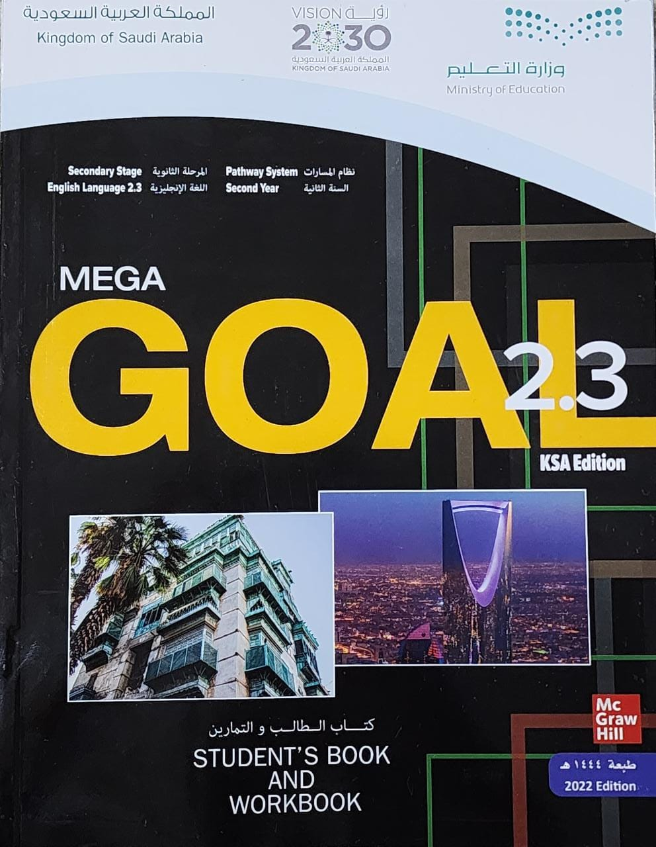
Book Open
Page ( 16)

Slide 4
Expressing Regret( Past )
Wish + Past Perfect
➔Use WISH for things happened in the past - you now Regret. This means we want to be able to change a situation in the past.
Form :
S + wish + past perfect ( had + V P.P3)
Example :
Past perfect
I missed the bus
I wish I had woken up early.
( I didn't wake up early and I missed my bus.)
Past simple
Past Simple
Past Perfect

Slide 5
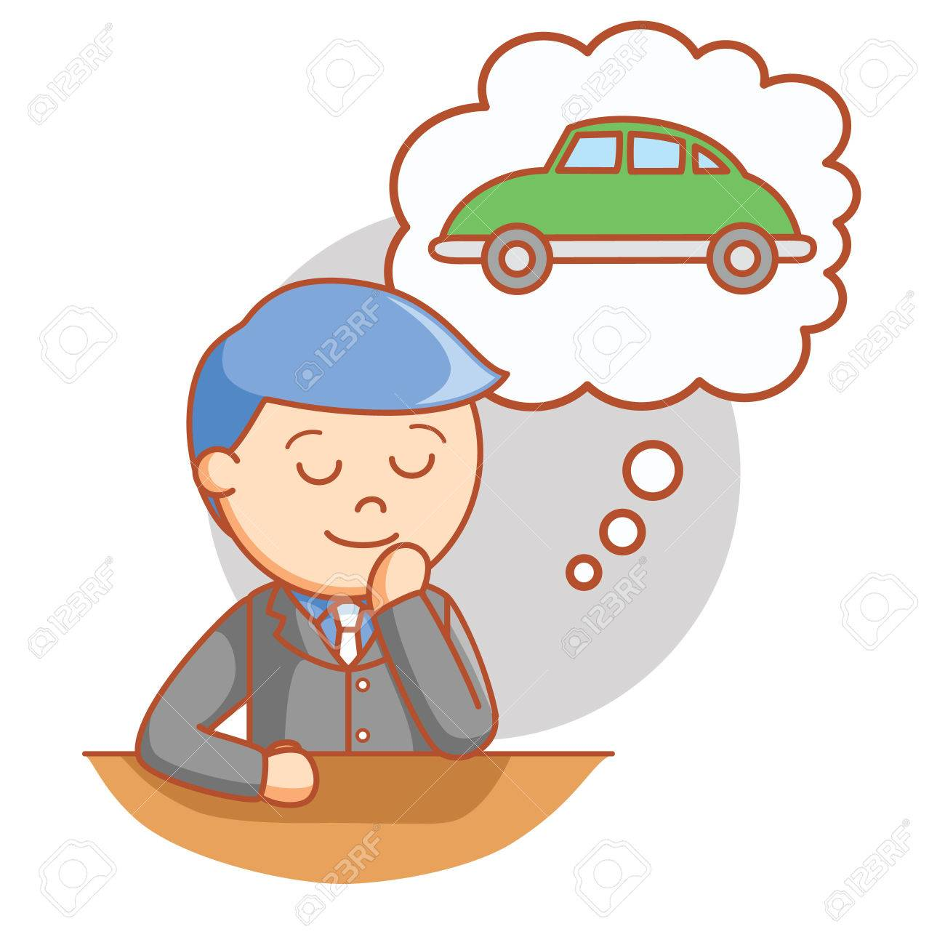
Expressing a wish( Present)
Wish + Past Simple
➔Use WISH & IF ONLY for things you want to happen now - probably won’t happen
Form :
S + wish + Simple Past
Example :
Past Simple
I wish I had a car .
( I don’t have a car and I would like to have it)
I don’t have a car
Present simple
Present Simple
Past Simple

Slide 6
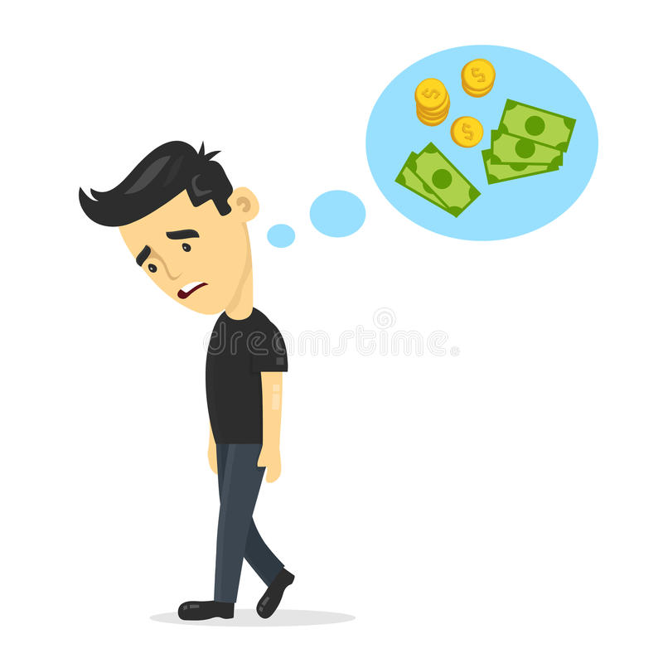
Expressing a wish( Present)
Wish + Past Simple
➔*When you use the verb to be the form is “were”.
Form :
S + wish + Simple Past
Example :
Past Simple
I wish I were a millionaire!
( I I don’t have a lot of money and I would like to have it)
I am poor .
Verb to be
Verb to be
were

Slide 7
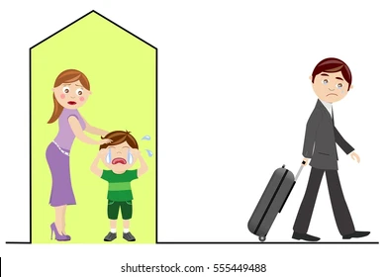
Expressing a wish( Future)
Wish + would ( infinitive)
➔*Use wish and if only for things you want to happen in the future but probably won’t happen.
Form :
S + wish + Future
Example :
future
I wish he would stay!
My father will leave for work soon
Future
Would + infinitive
future

Slide 8
Past Simple past perfect (had+ VP.P3)
Present Simple past simple
Future Tense ( would + infinitive verbs )
Note:When we use the verb to be the form is “were” with all pronouns

Slide 9
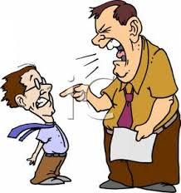
Expressing Criticism\Complaining
( Annoying Situation)
WISH + WOULD + Infinitive
➔Use WISH & IF ONLY express our annoyance. We hope that attitude will change in the future
Form :
If only / I wish + would + verb(infinitive)
Example :
Future+ infinitive
I wish he would stop yelling at me
( I'm annoyed because he always yells at me and I want him to stop)
My boss yells at me
Annoying action
Present action
Future

Slide 11
Book Open
Page ( 16)

Slide 12
it wasn’t so cold and wet. / I wasn’t so down.
he wasn’t so run-down and stressed. / he wouldn’t get sick so easily
would let me go out tomorrow night
I hadn’t taken my brother’s cell phone without asking permission
they would stop laughing
I had enough money to buy that present
I had watched the TV sitcom
the children would laugh at the clown’s jokes

Slide 13
Book Open
Page ( 17)

Slide 15
So …………….That
1- make the meaning of an adjective or adverb stronger
2- show cause and effect.
a) I was very tired .
The cause
b) I couldn’t finish my homework.
The Result
We join the two sentences using this form: So +Adjective + that
I was so tired that I couldn’t finish my homework.
Note:
omit “very” when you join the two sentences
The cause
The Result

Slide 16
Such …………….That
1- make the meaning of an adjective or adverb stronger
2- show cause and effect.
a) It is an amazing book .
The cause
b) I have read it many times.
The Result
We join the two sentences using this form: Such +Adjective + noun + that
adjective
noun
It is such an amazing books that I have read it many times.
The cause
The Result

Slide 18
Can’t, Could, Couldn’t, Must, May, or Might
What is the difference between them ?
can’t, must, may, or might
to make suppositions, to speculate about
something, and to draw conclusions.
must
to say we are sure of something
can’t or couldn’t
to say that we think something is impossible
may, might, or could
to say that something is possible.

Slide 19
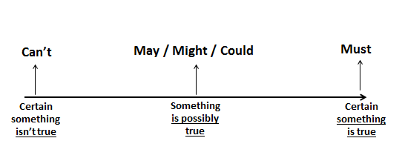

Slide 20
Match the sentences. Then use these ideas to write one sentence with so…that or such…that
1. d. I’m having such a good time that I don’t want to go home
d
2. a. The food was so spicy that it burned my mouth for half an hour after eating it
a
3. f. Emma is such a popular name that there are four girls in the class with that name.
f
c
4. c. The school is so selective that they only accept one student for every 100 applications
g
b
5. g. The company received so many complaints that they had to recall the product
e
6. b. My brother has won so many sports trophies that we’ve had to build a shelf to put them on.
7. e. You have made such a big meal that we will never be able to finish it

Slide 21
1. The fans look happy. Their team must have won the game. They can’t have lost.
2. Nawal looks angry. She may never stop shouting. / Her daughter must have done something terrible.
3. His parents are sad. He must be going to college.
4. The officer is surprised. The boy might have crashed into him.

Slide 22
Remember..

Slide 23
Homework
Workbook , page ( 90 ) exercise ( M )

Slide 24
Thanks

