Slide 1
Unit 1
Two Is Better Than One
Form , Meaning & Function
Mega Goal 5
Done by: Entisar Al-Obaidallah

Slide 2
Lesson Objectives
1
2
3
4
Pracice
Deffrentiate
use
Express
using Simple Present Tense .
words connected with Museums & Galleries
Enthusiasm with Intensifiers & adjectives.
between Simple Present & Present Progressive correctly .

Slide 3
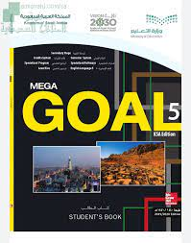
Open your studen’s book p . 16

Slide 4
1
Simple Present

Slide 5
Simple Present
1- facts and things that are true in general
2- talking about future timetables or schedules.
3- Exclamations with Here…! and There…! :
When we use the simple present ?
Example: Earth orbits the sun
Example: My flight to Dubai leaves at 08:10 tomorrow.
Q: Can I have the check, please? A: Of course, Sir. Here you are!

Slide 6
The difference between :
Simple Present Tense
Present Progressive
Activities regularly
Activities Now

Slide 7
Use Simple Present to talk about habits and routine
Examples:
I usually eat at home.
He plays football every day
They travel to London every year

Slide 8
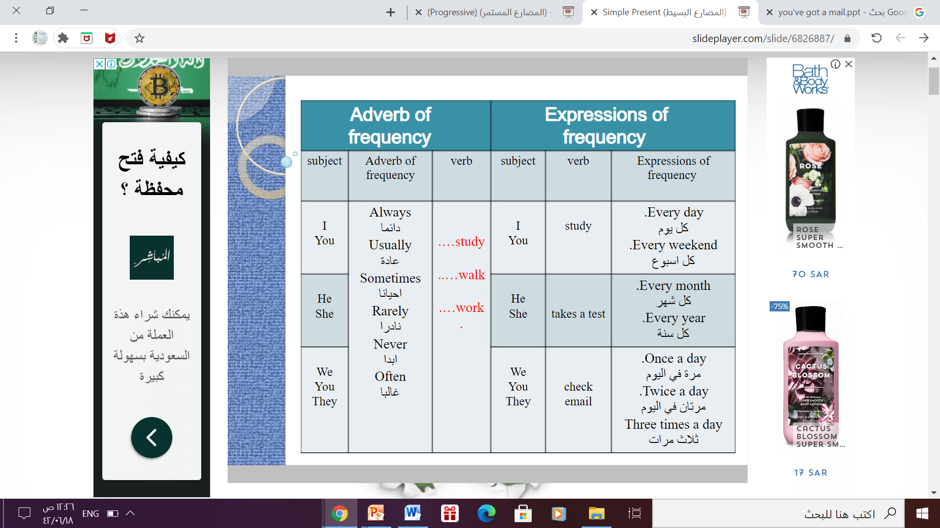
Key words of Present Simple Tense

Slide 9
Simple Present Structure
Simple Present
Simple Present
Form :
She
He VI ( s – es - ies)
It
Singular
She starts new diet
He drinks milk every morning
Form :
I
You
We V1 ( Infinitive)
They
plural
 I go to school every day
 They play football every week

Slide 10
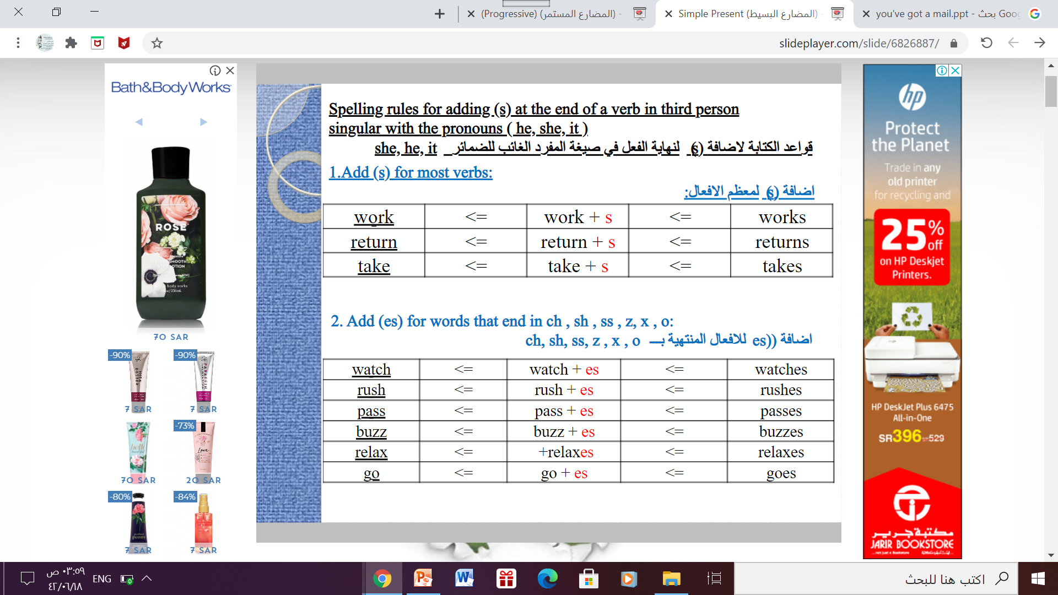

Slide 11
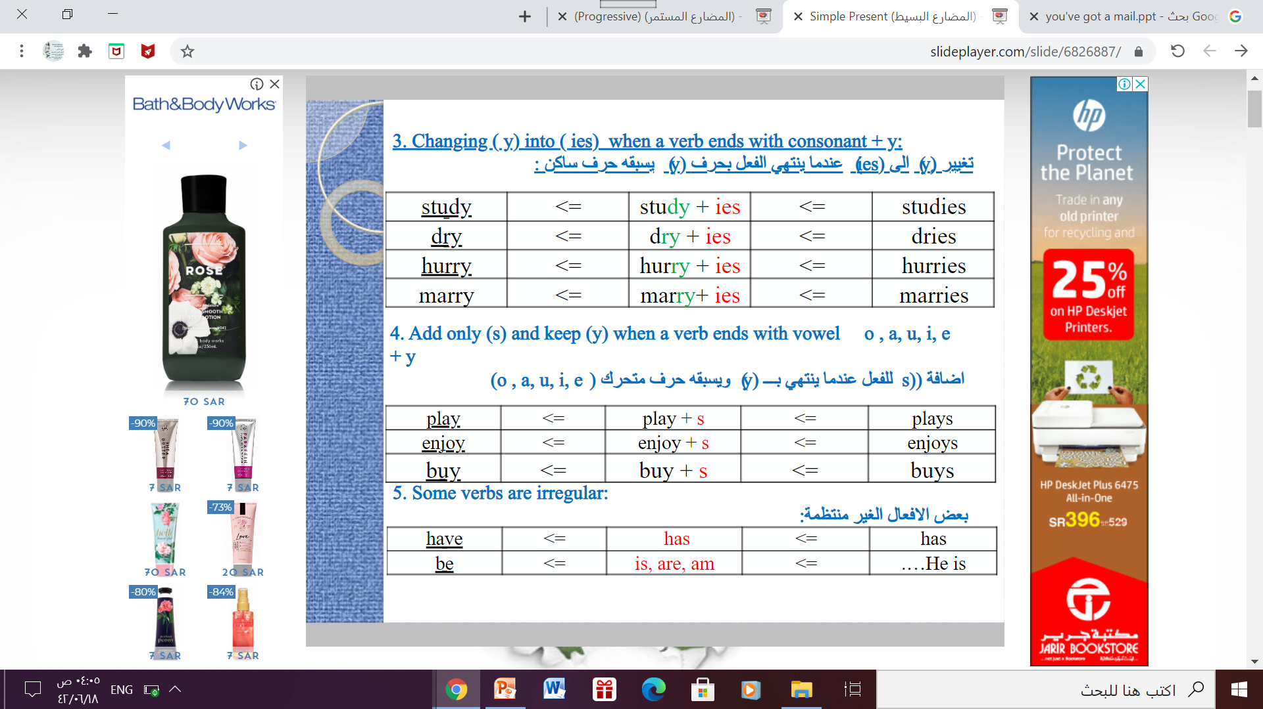
ACTIVITIES

Slide 12
Let’s Practice
Look at the pictures and make full sentences using simple present

Slide 13

She goes to school every day
Where does she go every day?

Slide 14
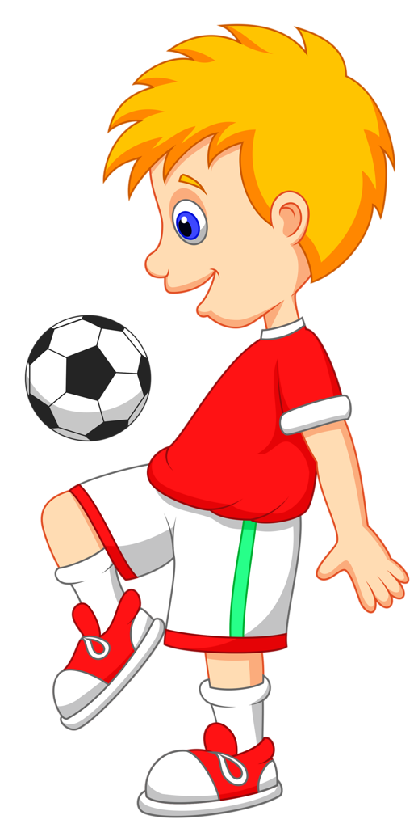
He plays football every weekend
What does he do every weekend?

Slide 15

The moon orbits the earth
What does the moon do?

Slide 16
2
Present Progressive

Slide 17
Present Progressive
1- Changing or developing situations.
2- Actions happening now.
3- Expressing temporary states
When we use the present progressive?
Example: You are getting taller and taller every day.
Example:. He is using a computer now .
Example : Ali is working at a cafe until he finds a job in his field.
4- describe an ongoing annoying situation or habit with always, continually, constantly.
Example :You are always interrupting me when I'm talking

Slide 18
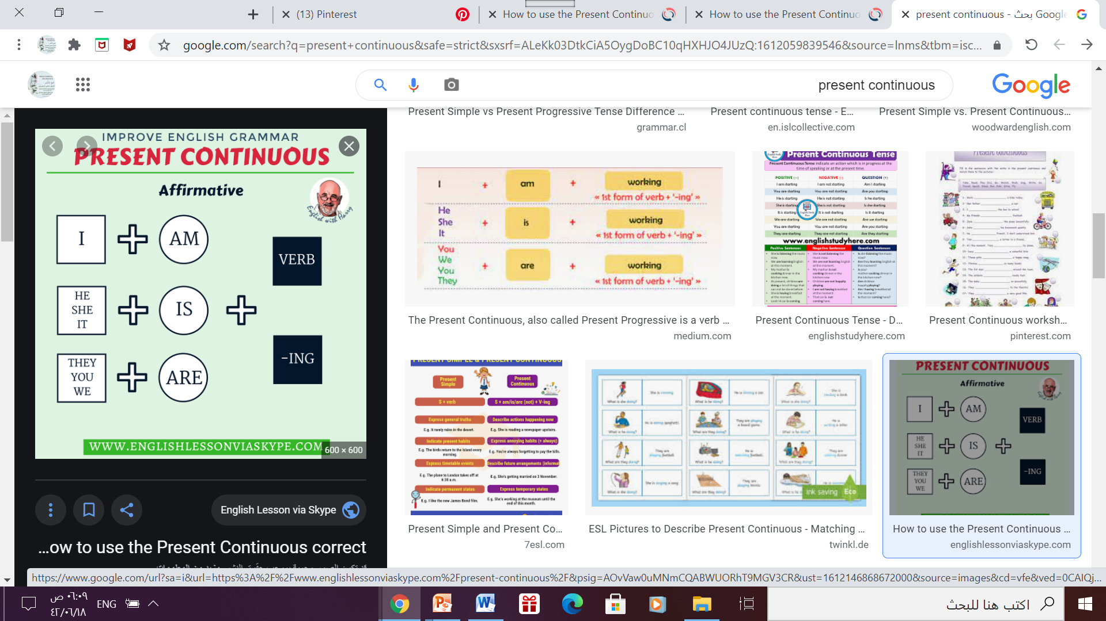
Strucure of
Present Progressive

Slide 19
Structure of Present Progressive
Form
Example
I am + V-ing
I am reading a new book right now
She - He - It is+ V-ing
He can’t talk now . He is brushing his teeth
You-We -They are + V-ing
They are watching a movie at the moment.

Slide 20
Note
Some verbs are NOT often used in the progressive form:
believe, think (opinion), know, remember, like, hate, want, prefer, see, hear, feel, seem, appear, have, belong, own.
These are called : Stative verbs

Slide 21
Let’s Practice
Look at the pictures and make full sentences using present progressive

Slide 22
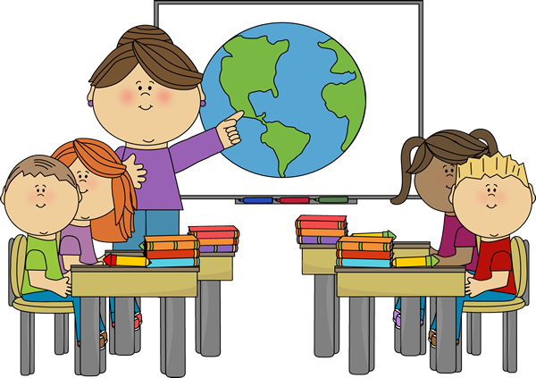
She is teaching the students
What is the teacher doing right now?

Slide 23

He is reading a book
What is he doing now?

Slide 24
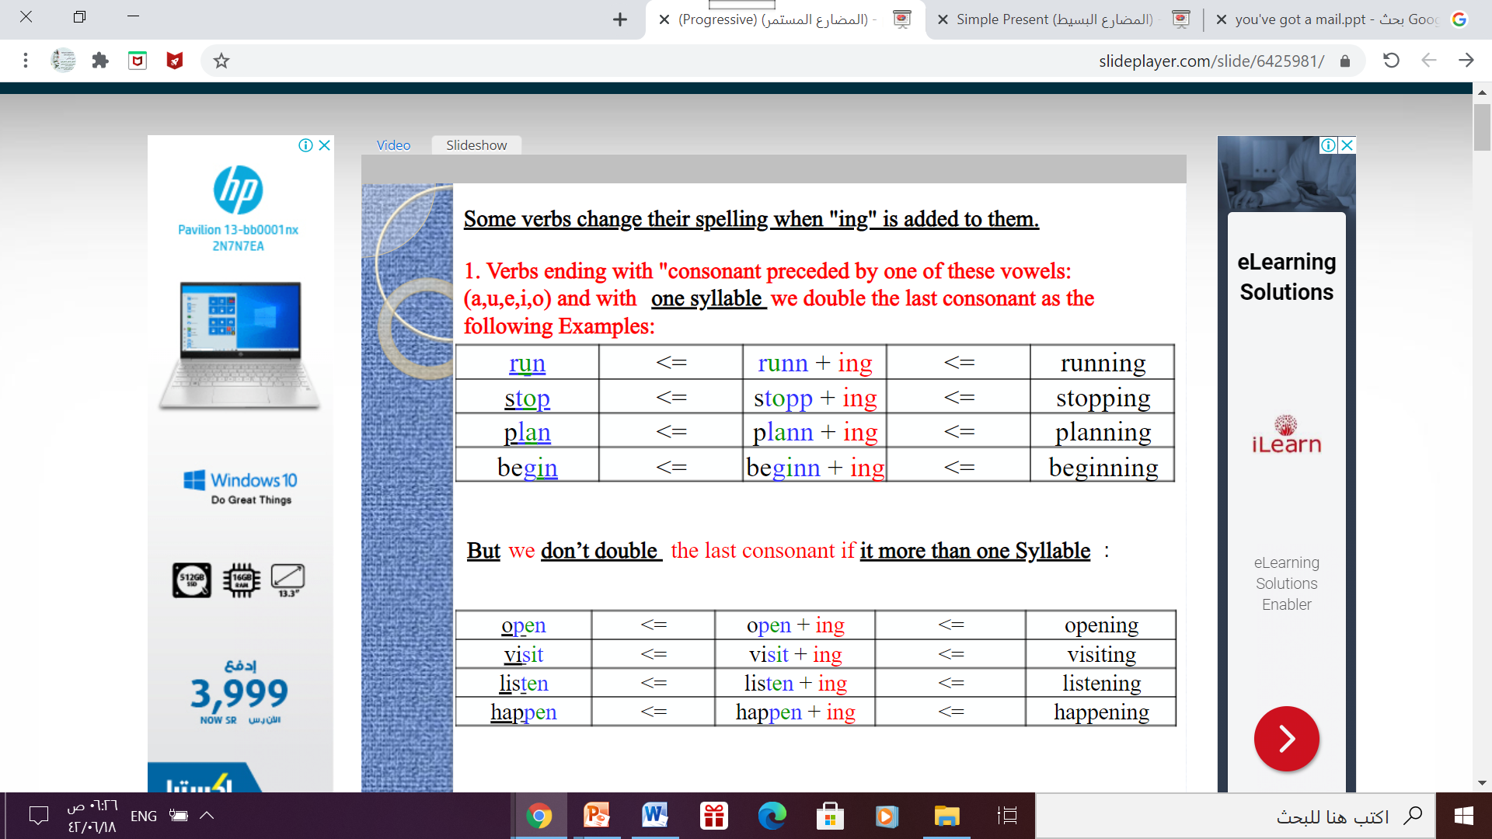

Slide 25
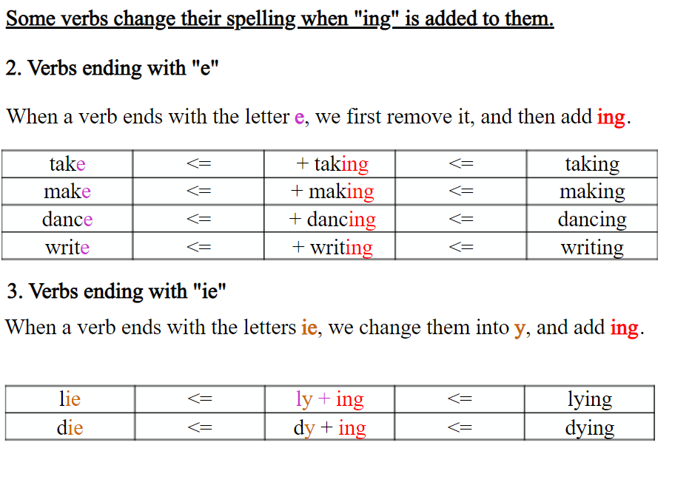
ACTIVITIES

Slide 26
Open your studen’s book p . 17

Slide 27
3
Words Connected with Museums and
Galleries

Slide 28
Words Connected With Museums and Gallaries
Some words we commonly associate with different types of museums and galleries are:
Archeological | Technological | National
history | Space | antiques
culture | robots | manuscripts
antiques | science | documents
pottery | seminars | state-of-the-art
jewelry | 3-D digital cinema showing | informative exhibits
exhibitions | scientific documentaries | interactive displays
ruins | educational books

Slide 29
4
Expressing Enthusiasm with
Intensifiers and Adjectives

Slide 30
We use certain intensifiers with each group of adjectives.
Expressing Enthusiasm with Intensifiers and Adjectives
We use the intensifiers really, very, absolutely and quite with adjectives to express our enthusiasm with something.
There are two kinds of adjectives: gradable and non-gradable.
Gradable adjectives can be measured in degrees, such as size, age, quality etc. Non-gradable adjectives cannot be measured like this..

Slide 31
Expressing Enthusiasm with Intensifiers and Adjectives
Gradable adjectives
Non-Gradable adjectives
very
really
Extremely
expensive
old
beautiful
important
good
interesting
frightening
small
Big
absolutely
really
Quite
priceless
ancient
stunning
crucial
amazing
fascinating
terrifying
tiny
Massive
Note: The intensifier really can be used with both gradable and non-gradable adjective

Slide 32

THANKS!

