Slide 1


Unit 2
I Wonder What Happened
Listen & Discuss
Mega Goal 1.3
Done by: Entisar Al-Obaidallah

Slide 2
Lesson Objectives
1
2
3
4
Speculate
Listen
Match
Ask
about some actions and events
for specific information
The sentences with suitable pictures
and answer about the photos using modals for speculation

Slide 3

Warm Up
Have you ever been involved in or heard of a situation that was mysterious and seemed no logical explanation?

Slide 4


What does “speculation” mean?
It is :the activity of guessing possible answers to a question without having enough information to be certain.

Slide 5
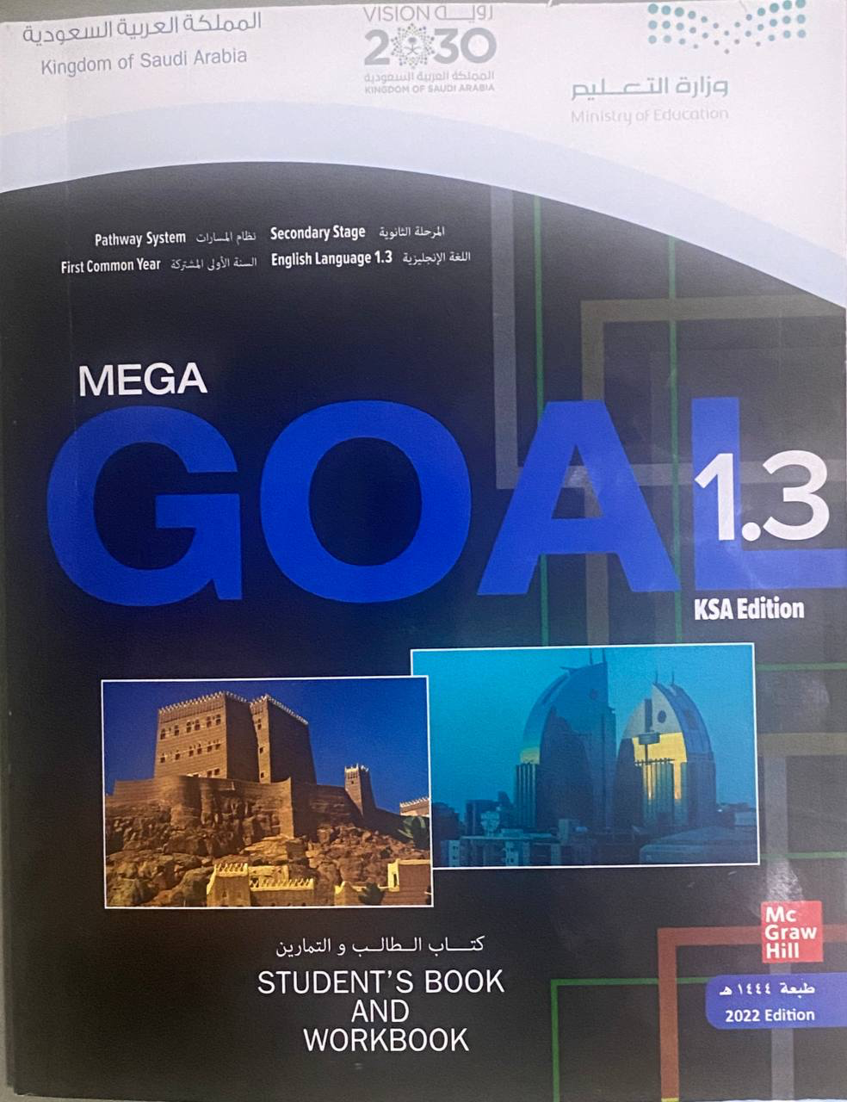
Open
Your student’s book
p. ( 20)

Slide 6
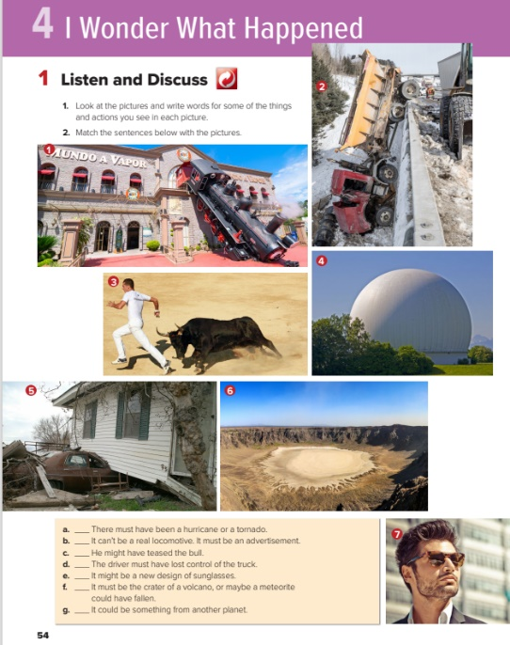

Listen and Discus

Slide 7
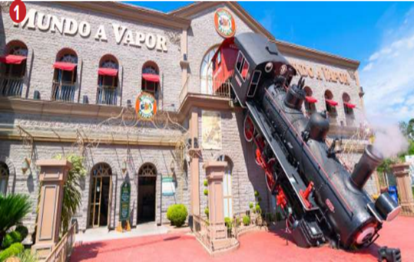
Look at the picture : What can you see??
What could have happened??
It could have been
train
an accident
advertisement
house
accident

Slide 8
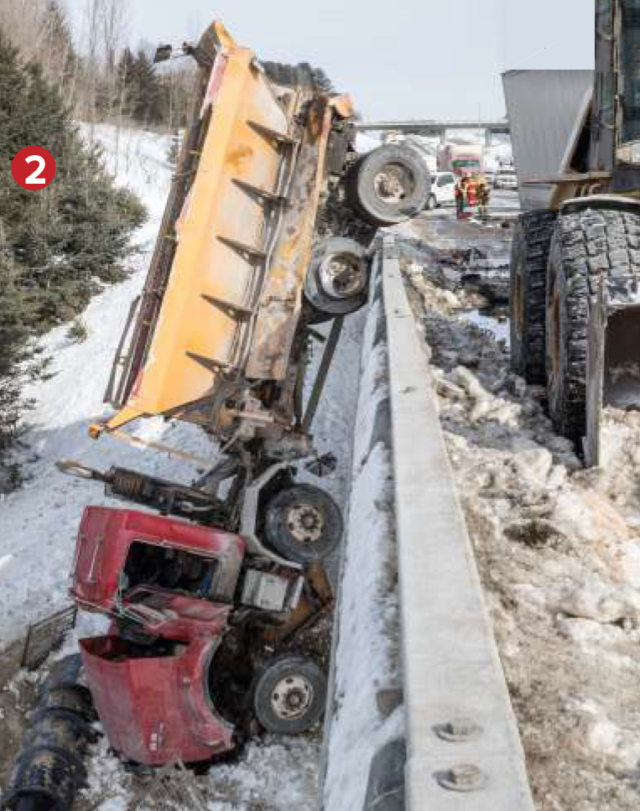
Look at the picture : What can you see??
What could have happened??
It could have been
truck
an accident
crash
Fast driving
road
Flat tire
accident
bridge

Slide 9
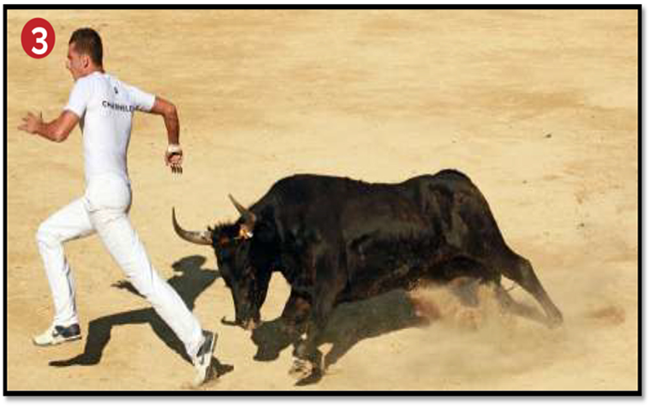
Look at the picture : What can you see??
What could have happened??
It could have been
man
Teasing a bull
A competition
angry bull
scene in a movie
Chasing

Slide 10
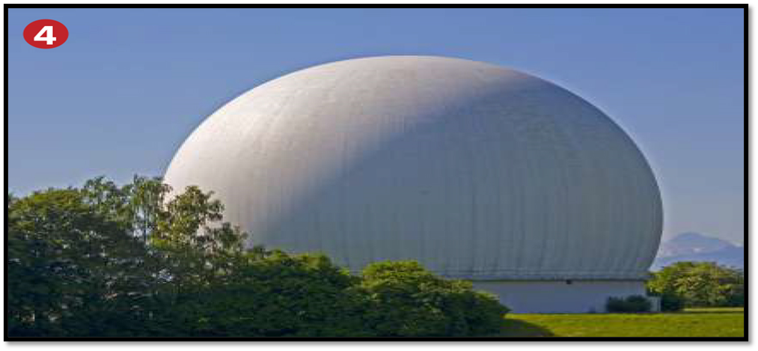
Look at the picture : What can you see??
It could have been
What could have happened??
trees
A new design
an experiment
sky
Something from outer planet
dome

Slide 11
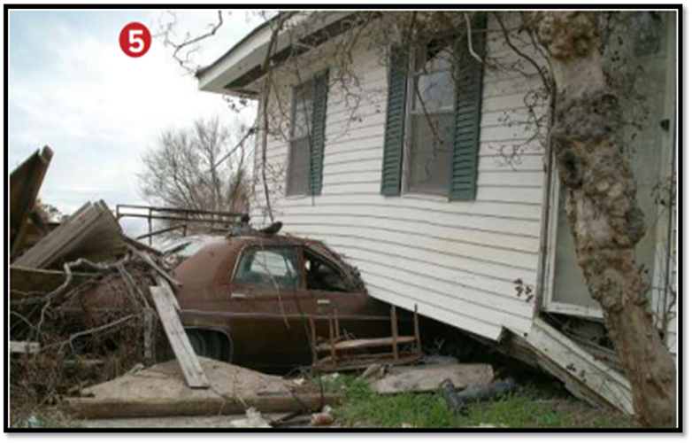
Look at the picture : What can you see??
What could have happened??
It could have been
house
Natural disaster
tornado
car
hurricane
accident

Slide 12
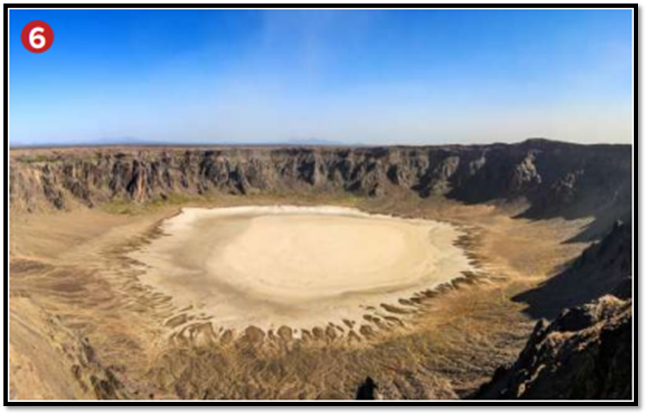
Look at the picture : What can you see??
What could have happened??
It could have been
land
A volcano
a fireball falling down from the sky
hole
sky

Slide 13

Look at the picture : What can you see??
What could have happened??
It could have been
man
advertisement for new brand of glasses
sunglasses

Slide 14
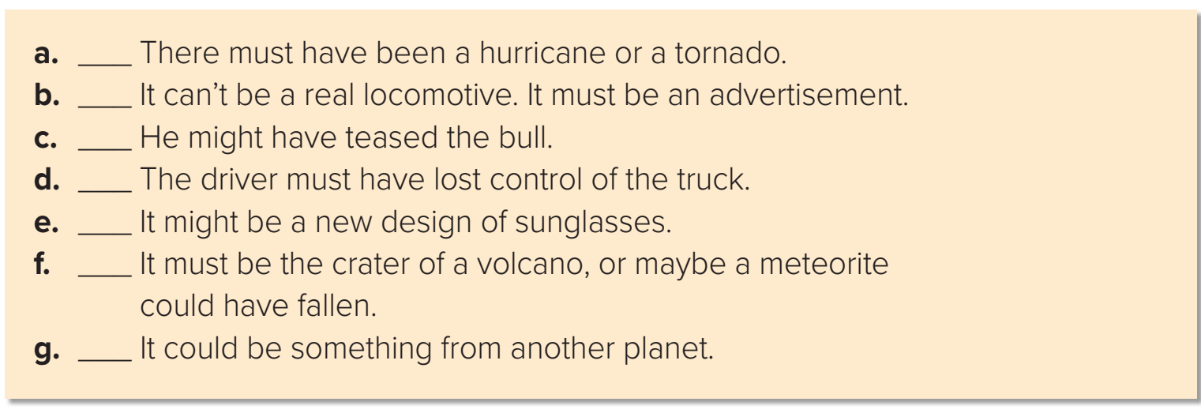
Match the sentences below with the pictures
5
1
3
2
7
6
4

Slide 15
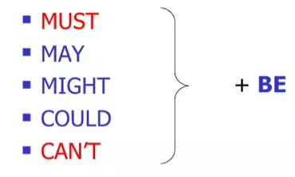

Ways to speculate about events

Slide 16
Open
Your student’s book p.( 21)

Slide 17
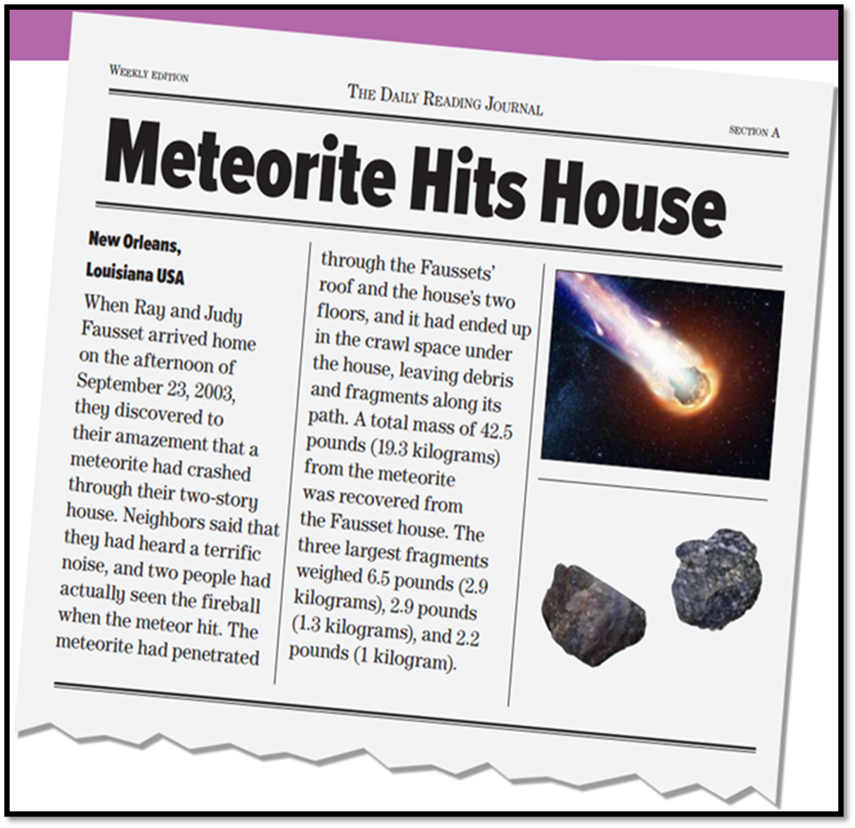

What is this?
It is an article in newspaper
What is the title of this article?
Meteorite Hits House
03
What happened to Ray & Judy Fausset’s house ?
It was hit by a meteorite .
When did that happen?
In September 23,2003

Slide 18
Journal = newspaper
meteorite = a space rock falls to Earth
terrific = very great or intense
03
penetrated = pass into or through
debris = the remains of something broken down

Slide 19
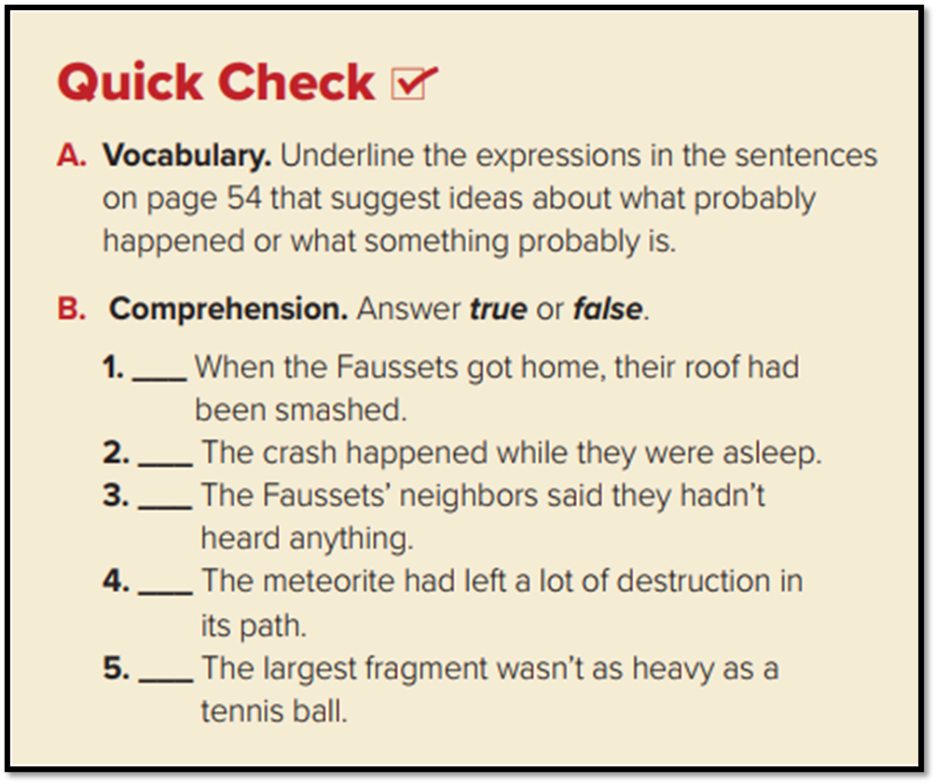
must have been
can’t be
must be
True
might have teased
False
must have lost
False
might be,
True
could have fallen
False
could be

Slide 20
Match the words with their meaning:
Meaning | Word
the remains of something broken down
a space rock falls to Earth
very great or intense
pass into or through
newspaper
Journal
debris
terrific
meteorite
debris
terrific
penetrated
meteorite
Journal
penetrated

Slide 21

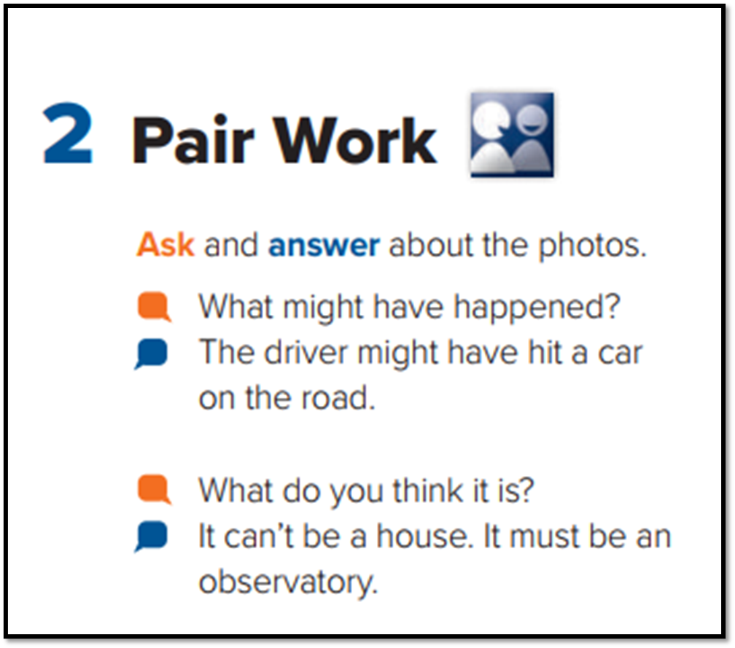
Now, your turn

Slide 22
Homework
P.(89) , Exercise( A)

Slide 23

Thanks

